Slide 2
Introductions
President Knapp

Slide 3
Return to Campus Plan
An Overview

Slide 4
Our Team of Experts
Medical
Occupational Health and Safety
Security
Faculty
Plant Manager
Academic
Student Services
Financial
Human Resources

Slide 5
CDC
MCCS
Governor’s Office, Executive Orders
DECD
Ford Motor Company
HR Peers throughout Maine

Slide 6
Communication
Internal
Academic
Residence Life

Slide 7
Campus Structure
One size does not fit all
Science vs Perception
Temp Scans
Finalize plan
Adapt/Update
Training

Slide 8
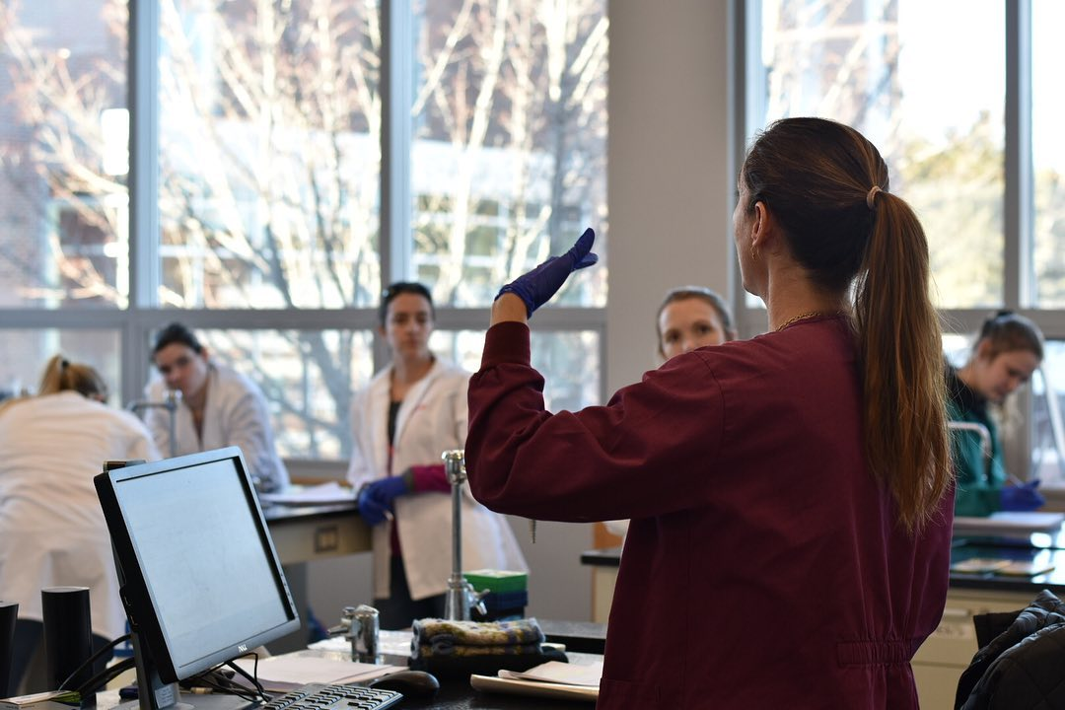
Overview of Instruction
582 Course sections - Fall
68% Online (400 sections)
23% Face-to-face (131 sections)
5% Hybrid: online with minimal required virtual sessions (30 sections)
4% Hybrid: online with minimal required face-to-face demonstrations (21 sections)
Classroom Strategies
Ensuring Compliance
Creative Solutions
Automotive Technology
Life Science labs
Challenges

Slide 9
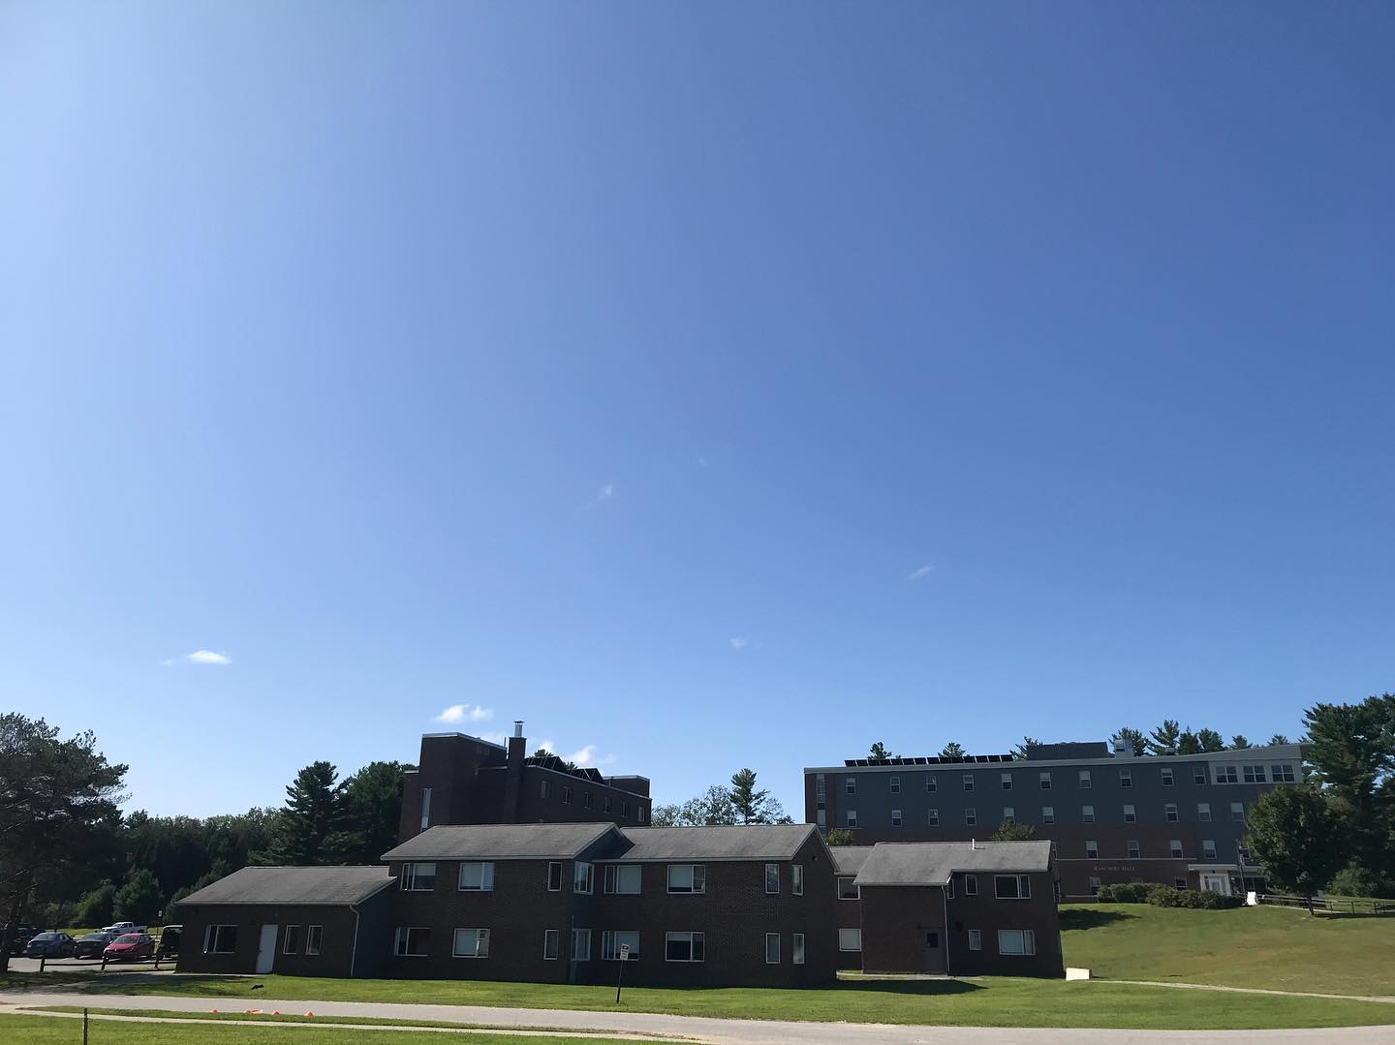
Residence Halls-an overview
Meeting SO and CDC guidelines
Compliance
Creative Solutions & Activities

Slide 10
Wrap Up & Questions for our Team
President Knapp

