Slide 1
Return to Campus Plan
Fall 2020

Slide 2
Thank you!
A special thanks is offered to Mary LaFontaine and the COVID-19 Task Force at Central Maine Community College, and special assistance from Kellie Morris in Central Services and all personnel in the Information Technology Department.

Slide 3
MCCS Required Elements of College Plans
Leadership Plan
Communications Plan
Health & Safety Plan
Facilities Plan
Academic Planning
Human Resources and Staffing
Transportation and Travel
Contingency Operations

Slide 4
Sources
York County Community College wishes to express its gratitude to the following sources of information and individuals who aided in the preparation of the College’s Re-opening plans:
Open Smart EDU COVID-19 Planning Guide
Center for Health Security Johns Hopkins Bloomberg School of Public Health
Tuscany Strategy consulting
Council for Higher Education Accreditation
Maine Center for Disease Control and Prevention Guidance on Prevention
US CDC Communities, Schools, Workplaces and Events COVID-19
US CDC Guidance for Institutes of Higher Education
OSHA Workplace Guidance
EPA/CDC Guidance for Cleaning and Disinfecting
American College Health Association
State of Maine (COVID 19)
State of Maine Governor’s Executive Orders
Maine Community College System Leadership and Staff
https://www.mccs.me.edu/wpcontent/uploads/MCCS-employee-guidance-3.18.20.docx-1.pdf
https://www.mccs.me.edu/wp-content/uploads/Mccs-employee-guidance-March-26.pdf
https://www.nytimes.com/wirecutter/blog/brass-touch-tool-instagram/

Slide 5
Preparing to Reopen – Two Locations
Leadership Guidance
Discuss enrollment, PPE, signs, cleaning, disinfecting, ventilation, contact tracing, protocols, policies, academic programs, financial resources, forecasting demand for supplies, contractors and supply chain, management and continued oversight, communications.

Slide 6
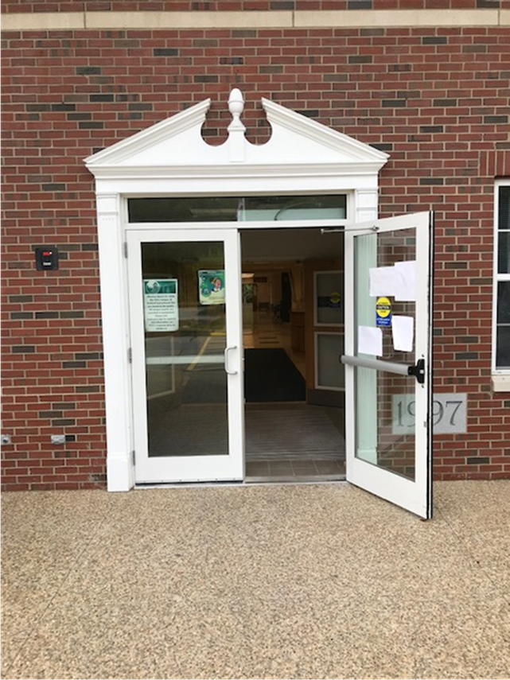
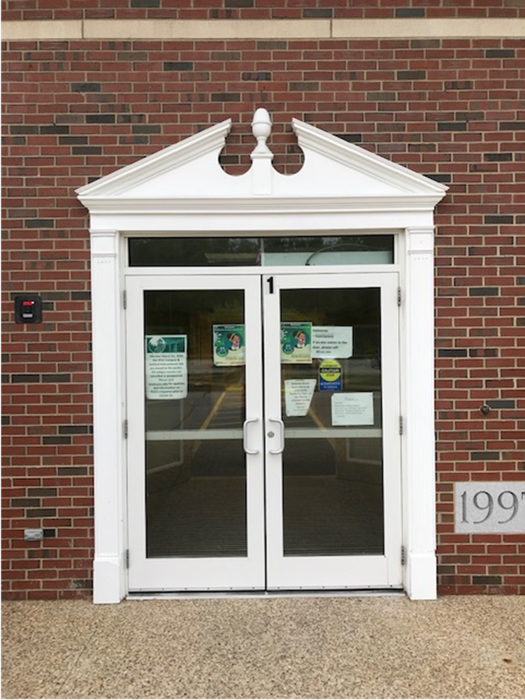
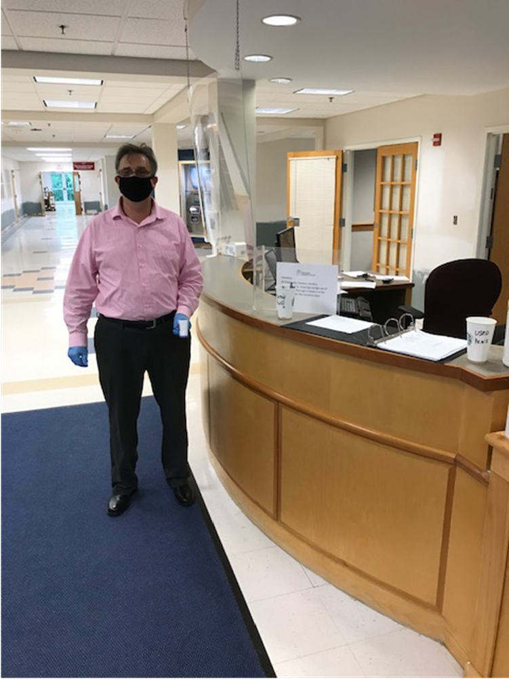
Campus Entrances

Slide 7
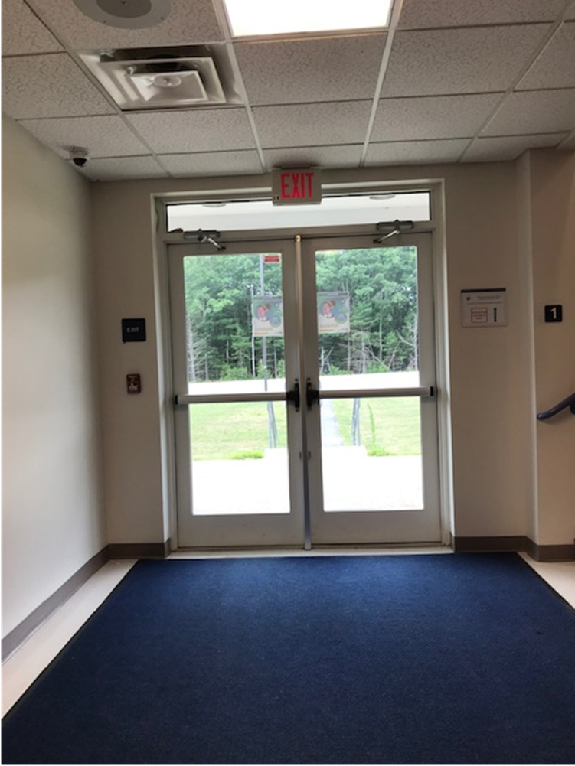
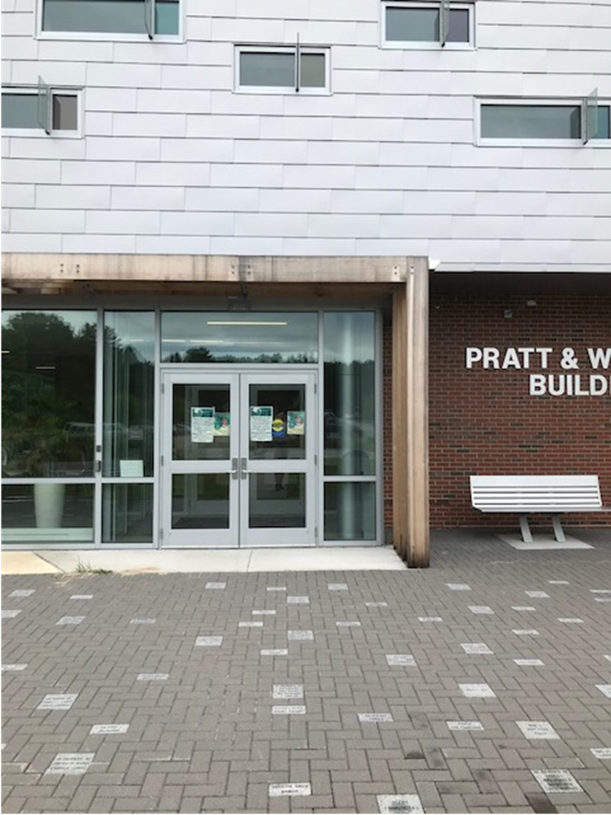
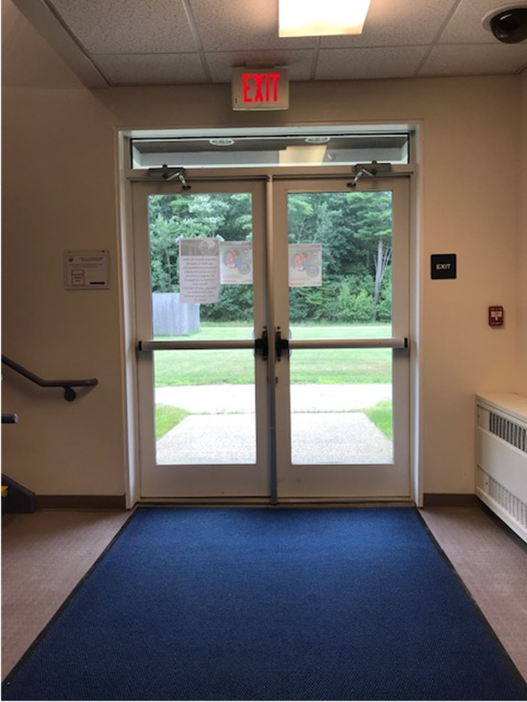
Campus Entrances

Slide 8
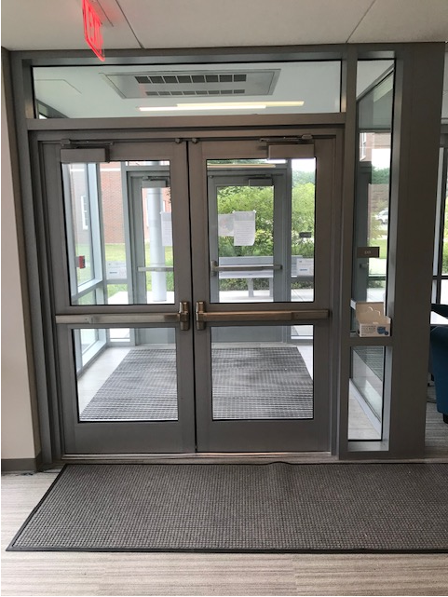
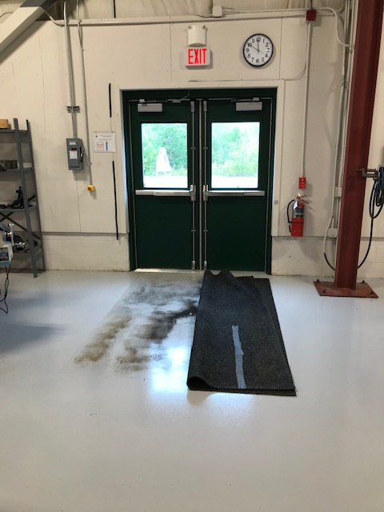
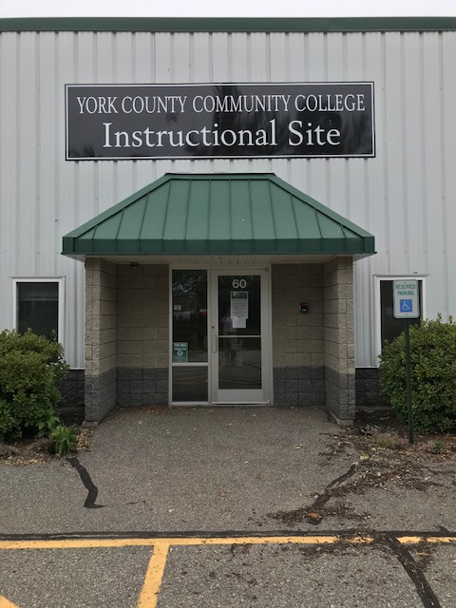
Sanford Instructional Site

Slide 9
Moving from Planning to Action, two locations
Cleaning & Disinfecting
Inside/Outside Airflow
Hand Sanitizer Stations
Social Distancing
Campus Access and Traffic Flow
Mail and other Vendor Deliveries & Guests
Safety and Health Screenings

Slide 10
Posters everywhere…

Slide 11
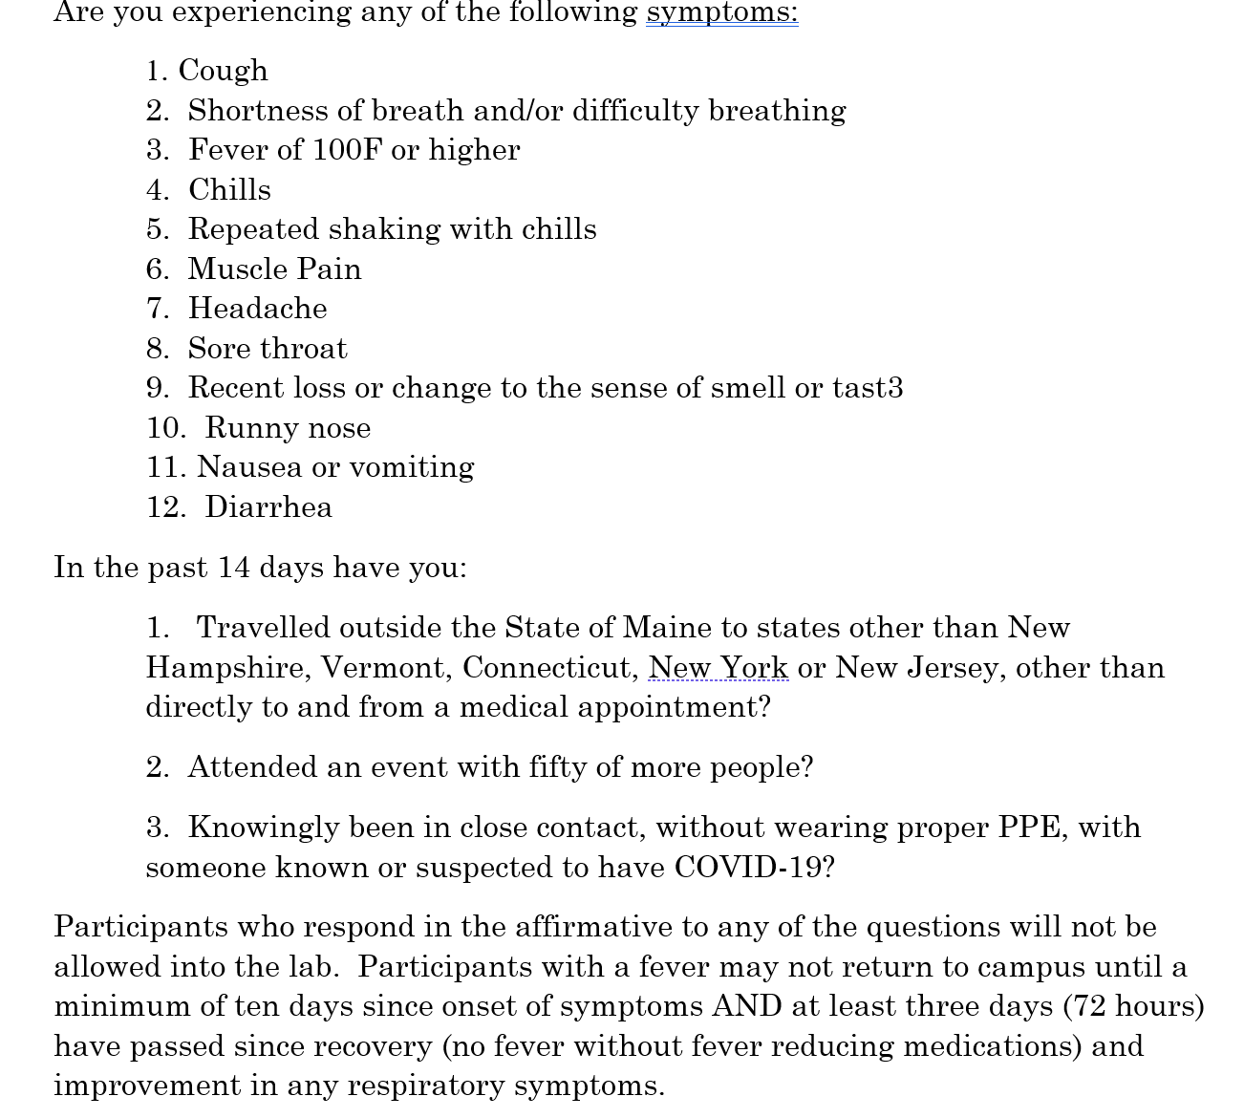
Entrance Screening

Slide 12
Campus & Site Reopening Requirements
High traffic, common and frequented areas will be disinfected per CDC guidelines, including regular disinfecting of frequently touched surfaces (door handles, hard surfaces, tables, chairs, etc.). Disinfecting of all common areas and classrooms being used for make-up labs will also occur every night by maintenance staff.
Additional cleaning supplies will be available in classrooms for students and instructors to clean learning spaces after use.
Hard surfaces such as desktops, tables, etc. in private offices are not cleaned by facilities staff but rather by employees using those items. Employees should clean and disinfect tabletops, desktops, cabinets, etc. within their own office space. Cleaning supplies will be made available in each office area.
Employees should bag and tie trash at the end of workday and place trash outside of their office area for pick up.

Slide 13
Campus & Site Reopening Requirements
When possible entry doors to office areas and multi-stall restrooms will be left open. Individuals should sanitize hands after opening the restroom door as an option to using paper towels. Hand air dryers will be taped off and should not be used.
All restrooms that are opened will be cleaned and disinfected a minimum of twice daily. High touch surfaces will receive additional sanitizing throughout the day.
Drinking fountains faucets at all locations will be taped off and disabled. The water bottle filling capability at these stations will remain available. Individuals will be asked to fill personal water bottles and/or bring personal beverages from home.
HVAC systems in college offices, rooms and spaces will be cleaned maintained and operated to best provide available ventilation for all areas. Where possible, office doors should remain open to provide additional ventilation as well as reduce the frequency of touches on door handles. Auxiliary fans have been removed from classrooms and common areas to prevent air from being blown directly on individuals. Employees should not use fans/heaters of any kind within offices or workspaces. Windows that do open should be opened to provide for fresh air flow.

Slide 14
Campus & Site Reopening Requirements
If a positive case of COVID-19 is identified in a YCCC facility, the appropriate cleaning protocols and contact actions will be initiated.
Plexi-glass barriers will be installed to protect front-line staff and where the primary function is greeting or routing students and guests.
Sanitation stations, including hand sanitizer, disinfectant wipes and other items will be placed throughout YCCC facilities.
Elevators will be available for only those individuals who must use them and will be for single use only.
Employees and guests should use their own pens or when a shared pen is needed, pens will be sanitized between uses.

Slide 15
Campus & Site Reopening Requirements
Never enter the campus when not well
Adhere to all entry and protocols and requirements
Wear a cloth face mask at all time (exceptions noted)
Practice social distancing at all times (defined in plan)
Individuals should limit meetings (or gatherings) to 10 or fewer people. When meeting, maintain physical/social distancing and wear mask/shield. Use Zoom or other forms of meeting whenever possible.
Individuals should wash hands several times a day with hot water and soap for 20 seconds, dry your hands with a paper towel.

Slide 16
Campus & Site Reopening Requirements
Employee should clear and clean desks daily. (The College’s facilities team will make cleaning supplies available in designated work areas.)
Employees should sanitize shared equipment (printers/copy machines) after use.
Individuals should cover all coughs and sneezes.
Individuals should be conscientious of others’ need to keep themselves safe.
Individuals should limit direct contact of frequently shared fixtures
Individuals should not gather in break rooms, hallways, bathrooms or offices.

Slide 17
Campus & Site Reopening Requirements
General Travel Precautions
All non-essential in and out of state travel for the College remains prohibited.
All college owned vehicles will be disinfected after each use.
Employees should not carpool with other employees, or those outside of their immediate household in college or personal vehicles.
Employees traveling for personal reasons should adhere to CDC and local health department guidelines regarding isolation after travel.
Employees must notify the Director of Human Resources if guests from outside the region or out of state are staying or visiting in their home. Employees realize they may be subject to a fourteen-day quarantine.
Individuals should not use public transportation when sick or experiencing symptoms such as those known to be associated with COVID-19
Individuals shall self-quarantine when required by the Governor’s Executive Order currently in areas other than NH,VT,CT,NY and NJ

Slide 18
A Plan to Reopen York County Community College
Communications
Establish a comprehensive and approved communication plan in conjunction with MCCS communication plans for all students and employees using various forms of communication such as Zoom meetings, e-mail, text, website, social media
Send a communication before returning to campus
Welcome
Include information on what has been done to ready the campus
Personal responsibility
Plans change
Send a communication on what to do when returning to campus
Entry ways, signage, masks, follow traffic routes, social distance
Include a president’s message with actual re-opening plan
Send a communication on what to do after returning to campus
Include instructions for students, faculty and staff on what to do when entering/working and studying on campus

Slide 19
A Plan to Reopen York County Community College
Communications (continued)
Send check in messages and reminder communications throughout the semester/year
Send a communication with guidelines for responding to and communicating about positive or presumed positive COVID-19 (Guidance provided by the System Human Resources)
Send a communication on how and where to seek assistance and support for students, employees and staff dealing with personal COVID-19 related social and emotional health issues
EAP
Safe Colleges
MEMIC
Local medical providers
Prepare a communication to be regarding the emergency shut-down of the campus and Sanford Site
RAVE

Slide 20
Message from the Taskforce Members
While the College strives to make York County Community College a safe and healthy environment for everyone who works, learns and visits with us, we ask each of you to commit to safe practices and do your best to ensure you remain safe and well.
Together we can all help to make our campus a safe place to work, learn and grow.
Members:
Jason Arey, Acting Director of Human Resources
Keith Cummings, Accounts Payable
Sophaktra Heng, Student Navigator
Lauren Mayhew, Computer Science and Technology Chair
Barbara Owen, Chief of Staff to the President
Mark Paradis, College Safety and Security Manager
Doreen Rogan, Dean of Academic Affairs

Slide 21
Message from the Taskforce Members
Below are the recommendations established by the Maine CDC that York County Community College will use to ensure the health and safety of our YCCC family and community.
Following recommended CDC guidelines/protocols for social/physical distancing
Following recommended CDC guidelines/protocols for wearing a face covering/mask
“Cloth face coverings” or “face coverings” include disposable face coverings of similar quality as well as face shields, provided that the face shield extends below the chin and covers the ears”
Washing hands with soap and water for 20 seconds
Sanitizing hands and keeping a clean work/study area
Taking care to self-certify our health
Taking your temperature
Wearing personal protective equipment as appropriate
Coughing and sneezing into tissues or elbows
Staying home if experiencing any symptoms such as (coughing, sneezing, temperature, dry eyes, sore throat)
Notifying your supervisor or human resources officials of exposure or confirmed cases

Slide 22
Academic Affairs: Teaching, Learning & Support
Fall 2020

Slide 23
Moving Online, wherever possible
Instructional Format | Percentage of Schedule
Asynchronous Online | 32%
Live-Online | 8.75%
Hybrid-Online | 10%
Originally scheduled Online | 39.27%

Slide 24
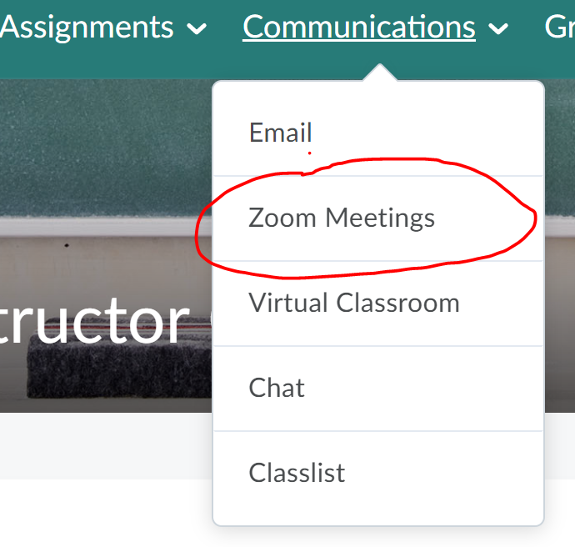
Strategies:
Lab kits for science courses (Chemistry, Biology)
Technology requirements for students (general and then specific programs)
Piloting a year without Dev Math
Changed textbooks to those with good online components and labs for students
Preparing video making sessions and trainings
Investigating tablets/app/keyboards that will assist instructors answer questions/explain concepts
Added Zoom to the Communications drop down in Brightspace

Slide 25
Challenges:
Postponed a pilot project for concurrent English course
Instructors new to online who rely on campus support – fear to move forward on their own
Need to update online resources/webpages for students and faculty
Need to delete/replace “Are online classes right for me?” prompts and activities on student pages
Need to shift instructor support to a tiered process with campus staff as the last option, instead of the first; Created schedule support sessions that can be reserved from webpages

Slide 26
Additional Costs: Limited
Lab kits so the additional costs don’t go to students
Recording equipment for demonstration videos
Reducing redundant sections (cancelled or ghosted) with all online

Slide 27
Essential Labs w/F2F Components
Culinary Arts
Medical Assisting
Precision Machining
Veterinary Technology

Slide 28
F2F Labs
Instructional Format | # of Courses | Programs
F2F – hybrid | 3 | Culinary, Vet Tech
Onsite-classroom | 18 | Culinary, Med Assisting, Vet Tech, Precision Machining
Offsite (farms) | 3 | Vet Tech
Total sections | 24/10% of courses

Slide 29
Strategies for F2F Labs:
All face-to-face instruction is set to end at Thanksgiving
Creating videos for demonstrations for BS to reduce time in labs

Slide 30
Culinary Arts & Medical Assisting
Culinary:
All required 7-week labs were moved to term I
All items used during labs will be placed in individual cleaning buckets
Students will clean their own kitchen utensils, dishes and appliances
Med Assisting:
Dividing students into two smaller groups
Utilizing different textbook with good online materials

Slide 31
Veterinary Technology
Vet Tech has learned from Culinary:
Creating individual bags of items to work with;
All individual equipment used will be placed in bowls/buckets to be cleaned at the end of class
Planning to send students home with animals – a rat and a mouse each and a Release of Liability Form (thank you Amy!)

Slide 32
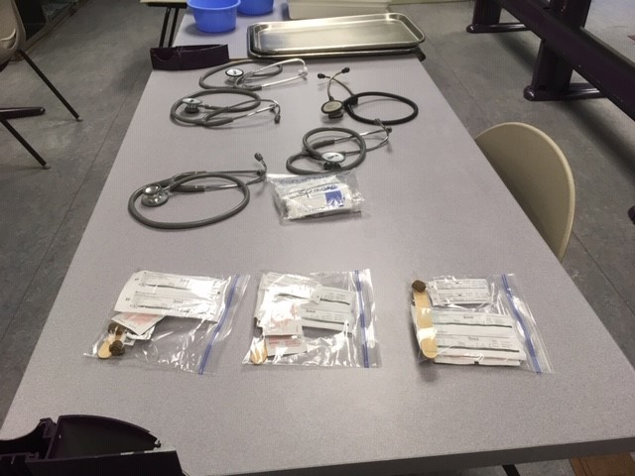
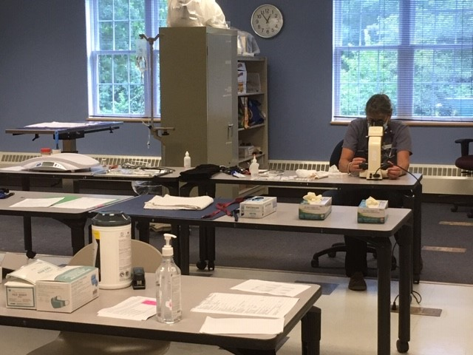
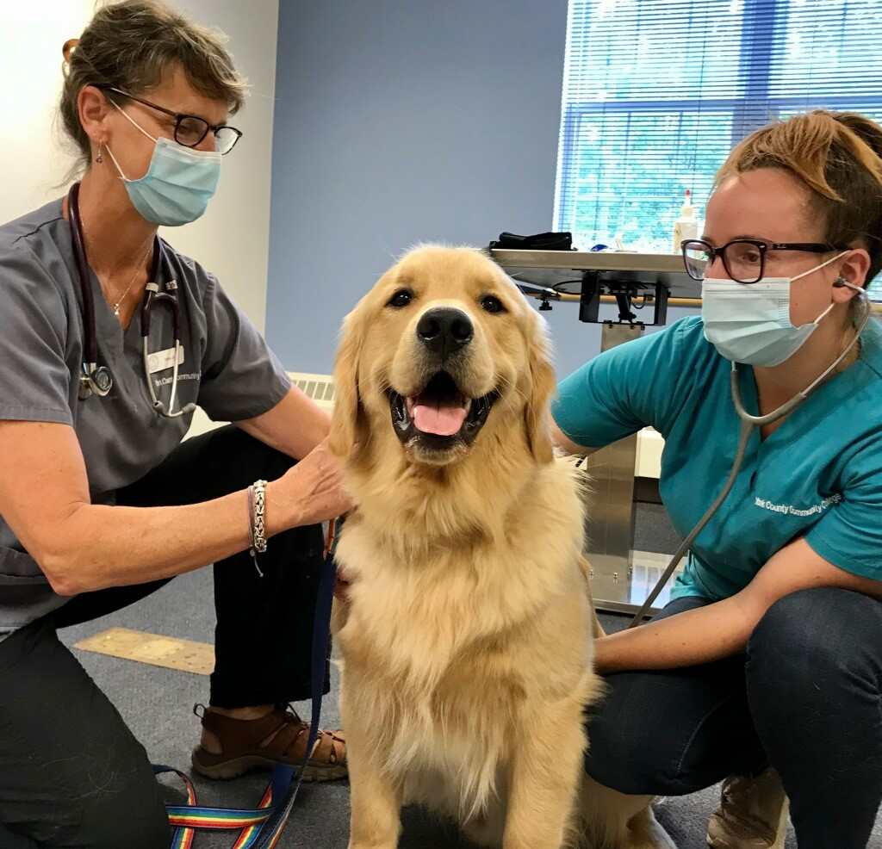
Veterinary Technology Labs

Slide 33
Precision Machining Labs
Lab courses: all lab courses will utilize Brightspace for lecture, demonstrations where possible, written assignments, and testing
First Year and Second Year Courses will be offered on opposite days
Students will be divided with half attending the f2f labs on Tuesdays and half attending on Thursdays.
Lab instruction includes the use of simulators. The simulators will be moved and spaced throughout the lab to allow physical distancing of at least 6 feet. Use of simulators will be either by appointment or during the lab time on the days they are scheduled on campus.
May cycle in shifts of 3 students at a scheduled time block.
OSHA10 training and certification will be fully online and embedded early in the semester.
Plexiglass barrier on wheels for the instructor to use when working closely with a student on a machine

Slide 34
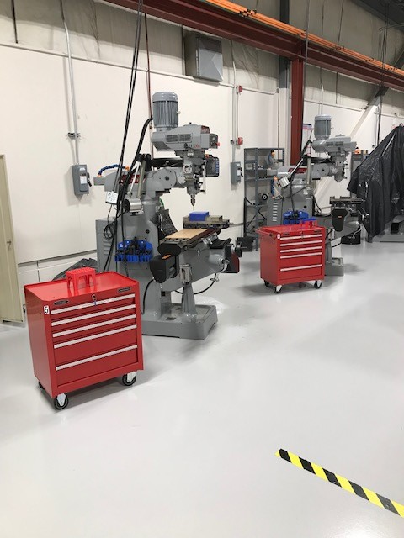
Precision Machining

Slide 35
Challenges for F2F Labs:
Night sections
Farms – some are humid with limited air circulation (dairy)
“Lending” animals for Vet Tech students

Slide 36
Additional Costs: Limited
Some additional costs for purchasing food to use for demonstration videos
Separation of toolboxes and tools
No additional teaching schedules for full-time faculty
Three additional labs added to Vet Tech (adjunct & lab assistants)

Slide 37
Workforce
Online except for:
Phlebotomy Labs on campus; groups of 5 at a time
Medical Assisting; 5 workforce students have been added to our online and F2F labs

Slide 38
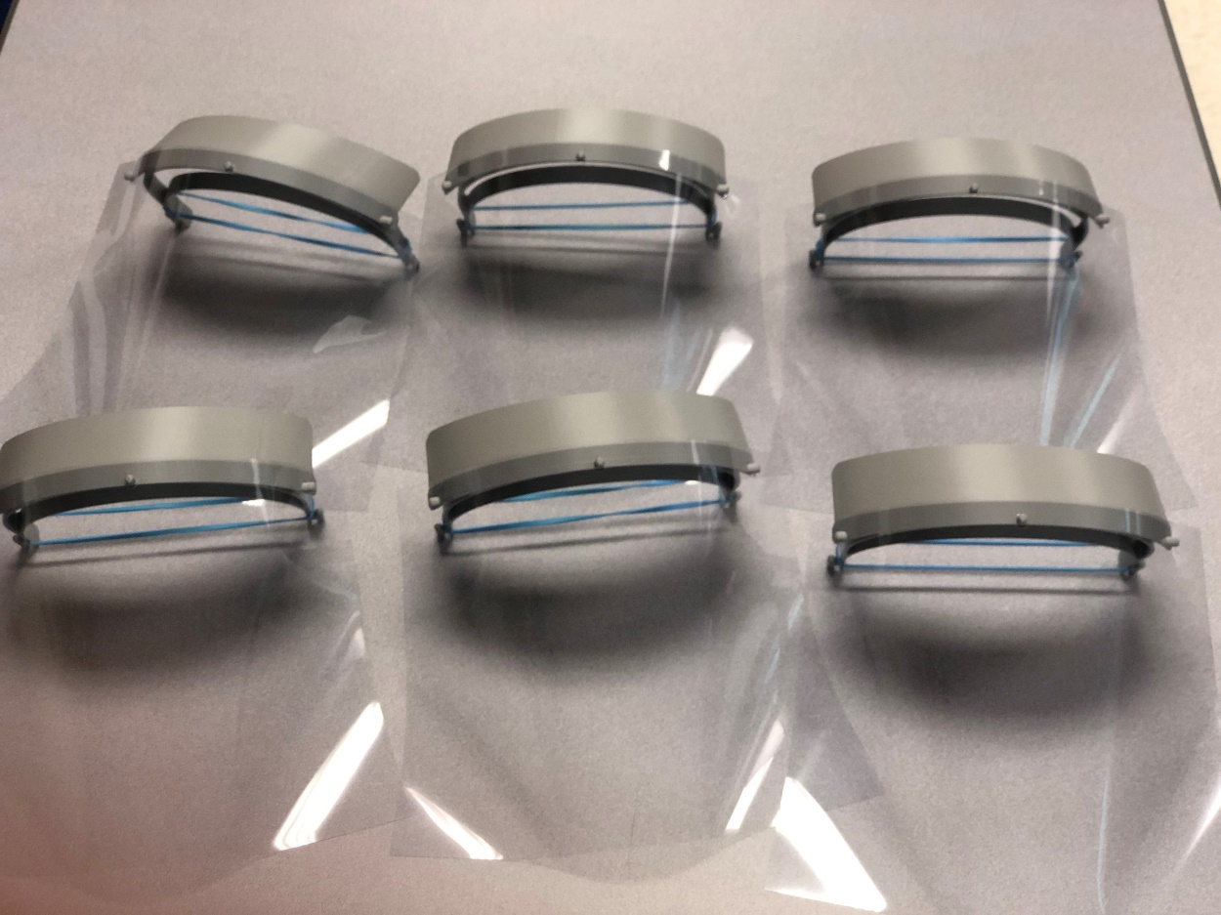
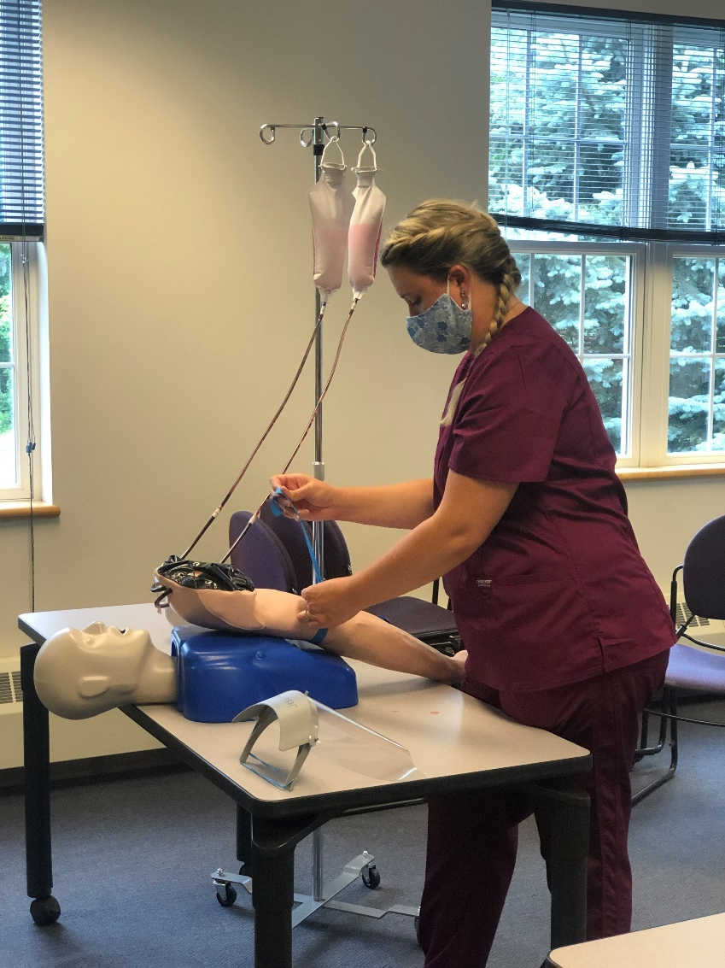
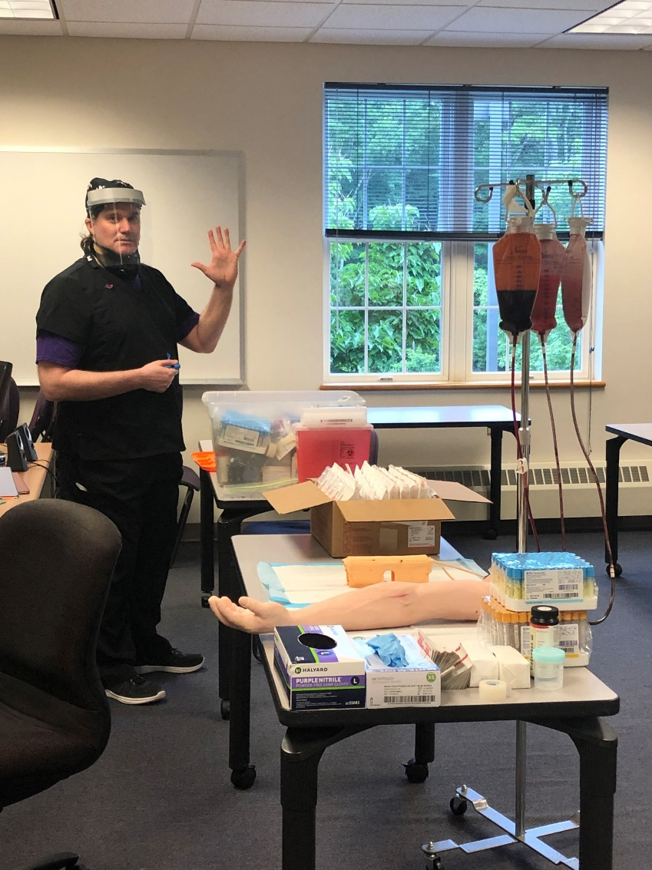
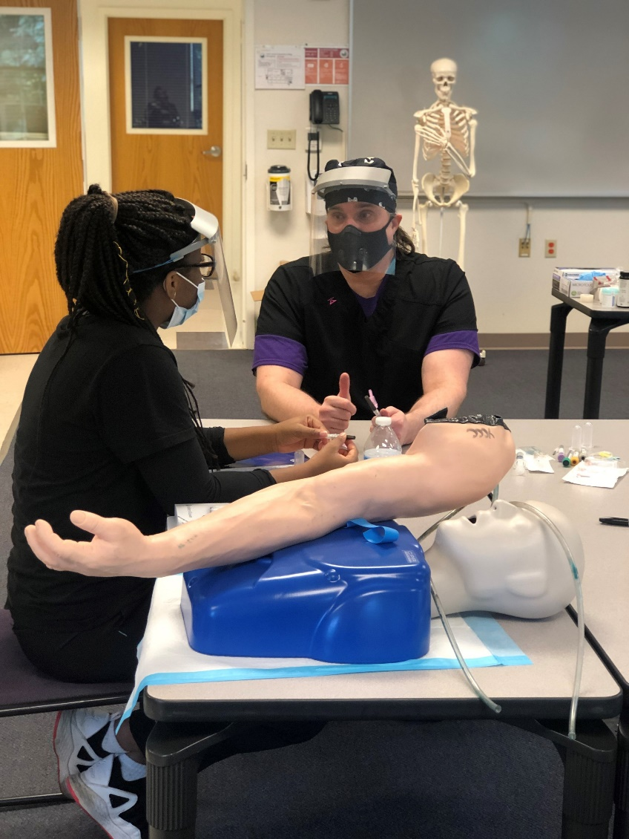
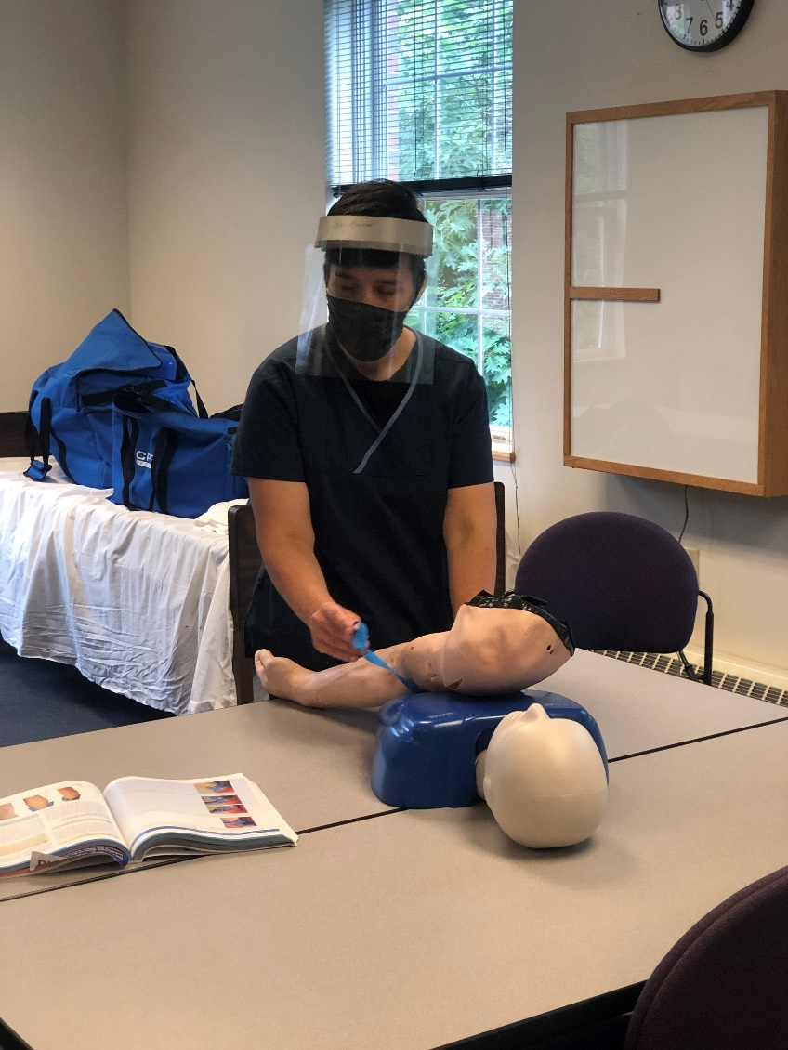
Phlebotomy Labs

Slide 39
Academic Support for Students:
All academic support services are prepared to support students remotely and with limited F2F options by appointment. (Student Success Commons/Library, TRiO, Disability Services)
Students:
library resources and instruction
tutoring and mentoring
support for online students
disability services

Slide 40
Academic Support for Faculty:
All academic support services are prepared to support faculty remotely and with limited F2F options by appointment.
new instructor orientation
online instructional assistance
course shell templates
professional development

Slide 41
We welcome your questions and suggestions…

