Slide 1
AND WE SOAR

Slide 2
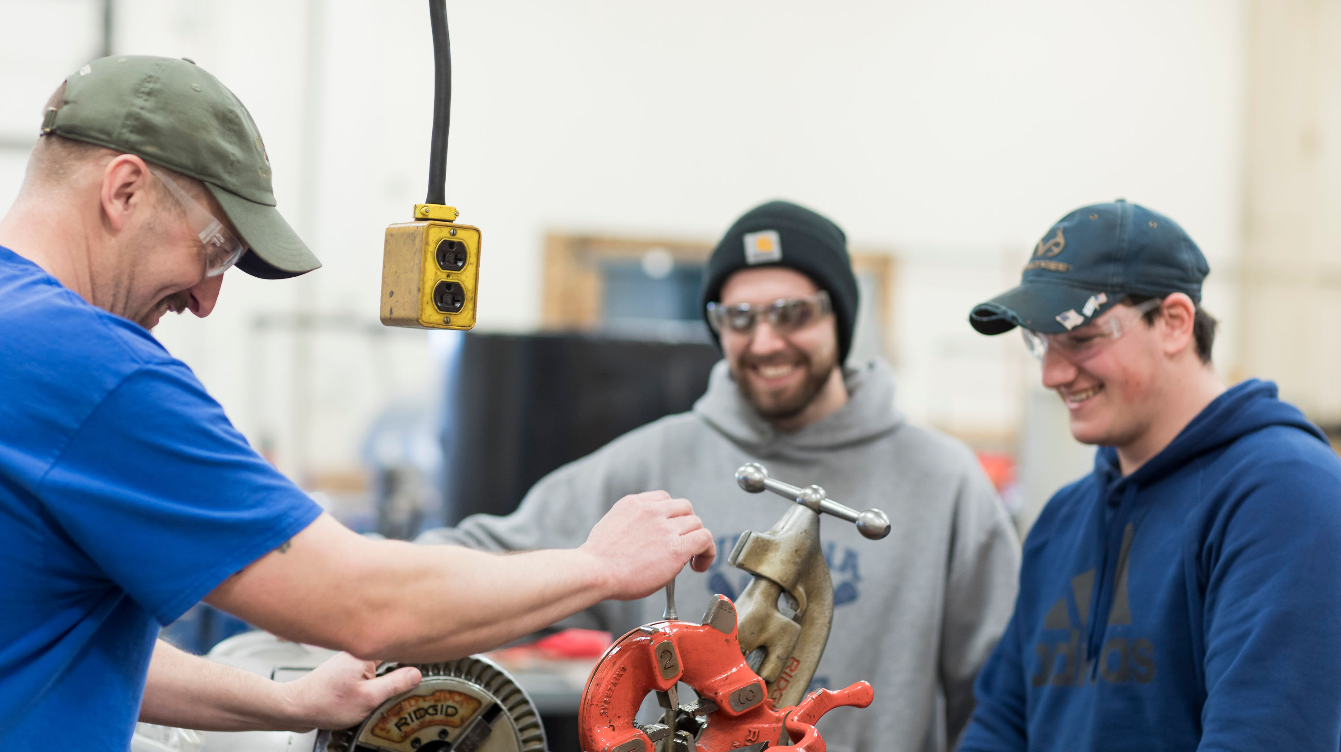
Guiding Our Work
Protect the health and safety of the WCCC community;
Ensure the academic progress of our students and provide access to student services and technology support to ensure student success;
Fiscal prudence, and
Continuity of WCCC operations in any environment (e.g. live, remote, and online).

Slide 3
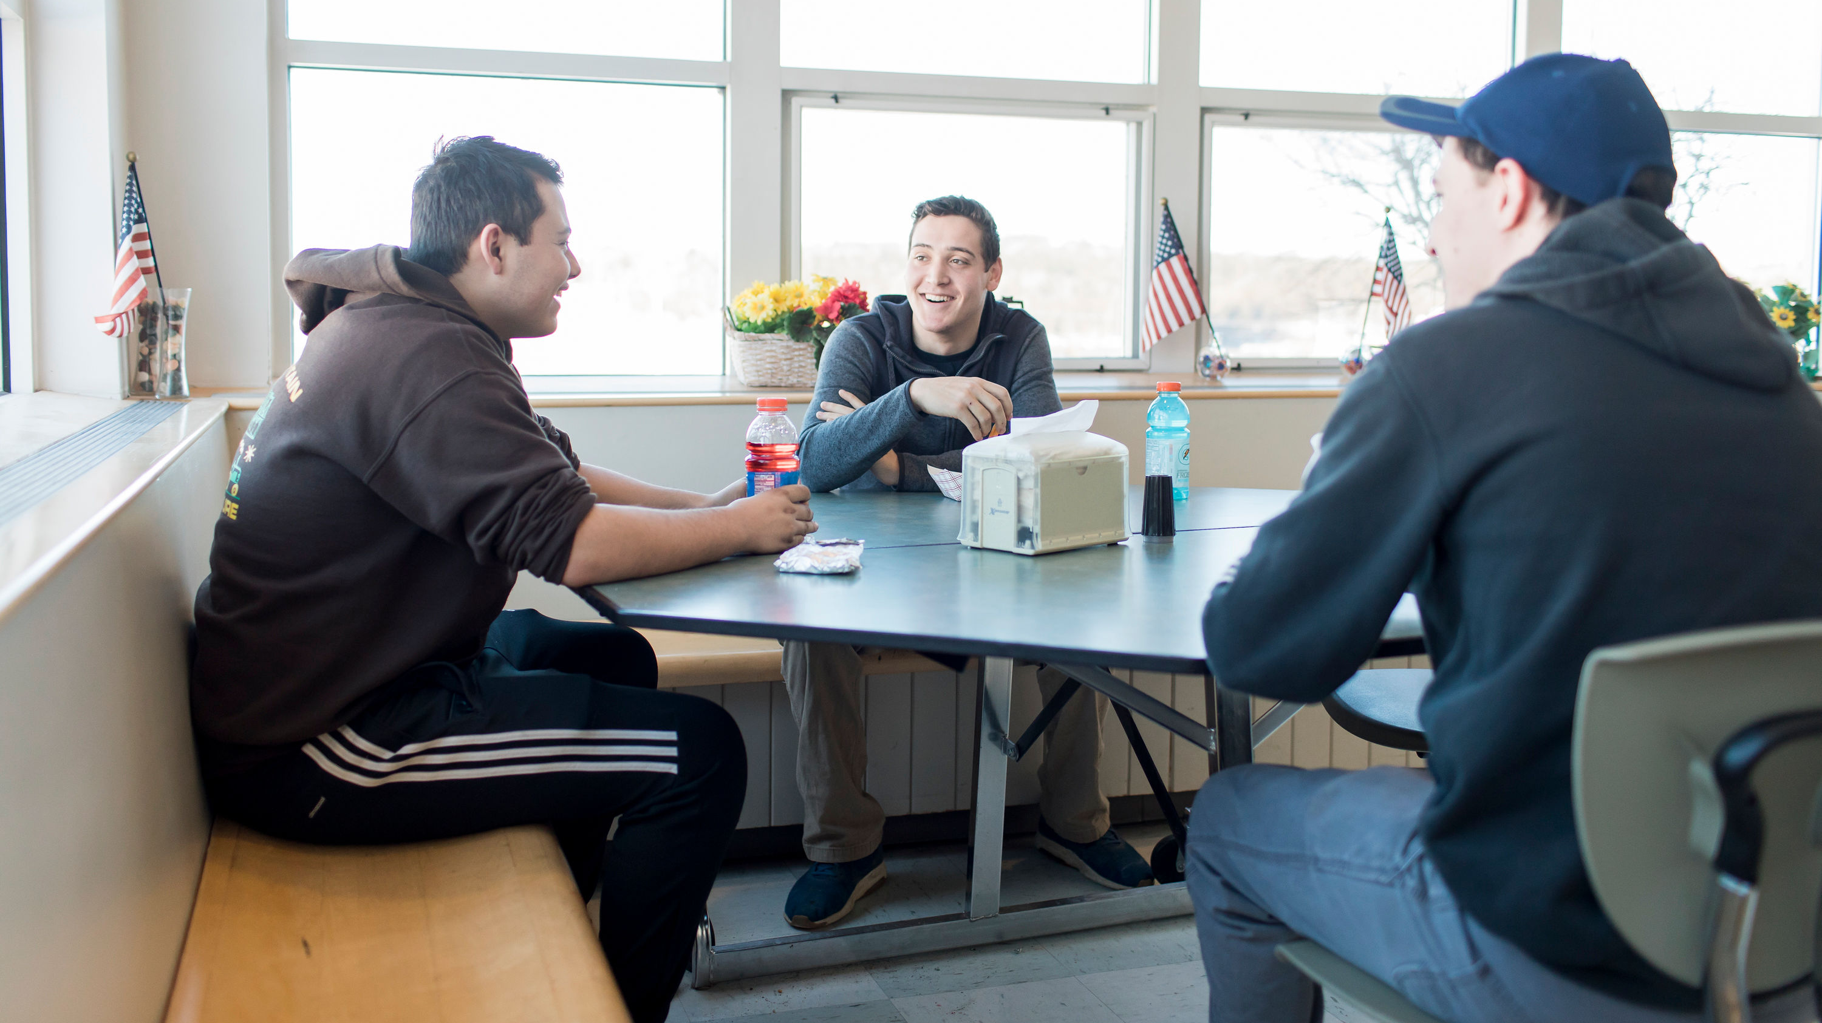
Guiding Our Work
United States and Maine Center for Disease Control (CDC) Guidance
Environmental scans of Washington County, Maine, and New England
Collaborative campus planning, assessment, and communication process
Conversations with medical and community partners
Plan, monitor, adapt, respond, and execute decisions based on data

Slide 4
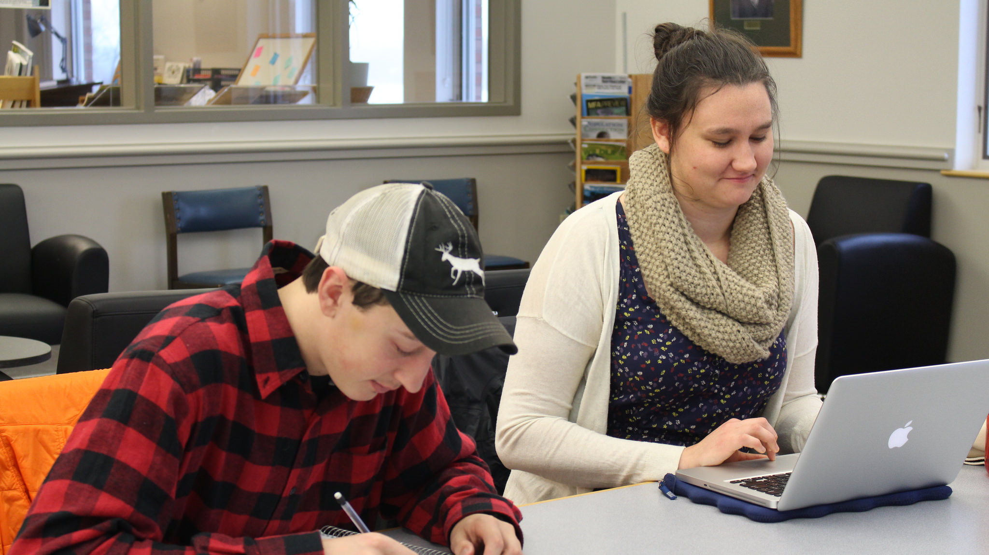
Protecting Our Campus Community
Securing our campus community and limiting access
CDC guidance cleaning and sanitization; face cloth masks; hygiene; and social distancing
Pathways with signage to support social distancing
Daily self-screening certifications and sign-in/sign-out
Training and education programs for students and employees (SafeColleges)
HVAC Systems

Slide 5
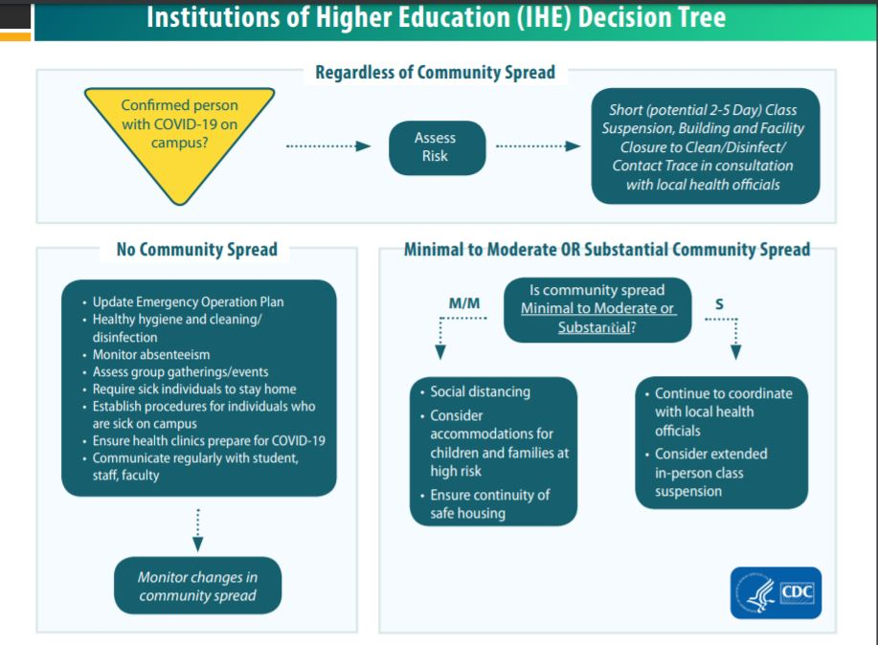
Protecting Our Campus Community
CDC Decision Tree
Infectious Disease Response Team
Stabilization Plan for Outbreak

Slide 6
Fulfilling Our Academic Mission
Hands on learning in shops and labs with smaller student cohorts, simulations, and use of personal protective equipment
Clinical and practicum experiences
Protective equipment for faculty and students
Reduced classroom and shops capacities
Investing in new technology

Slide 7
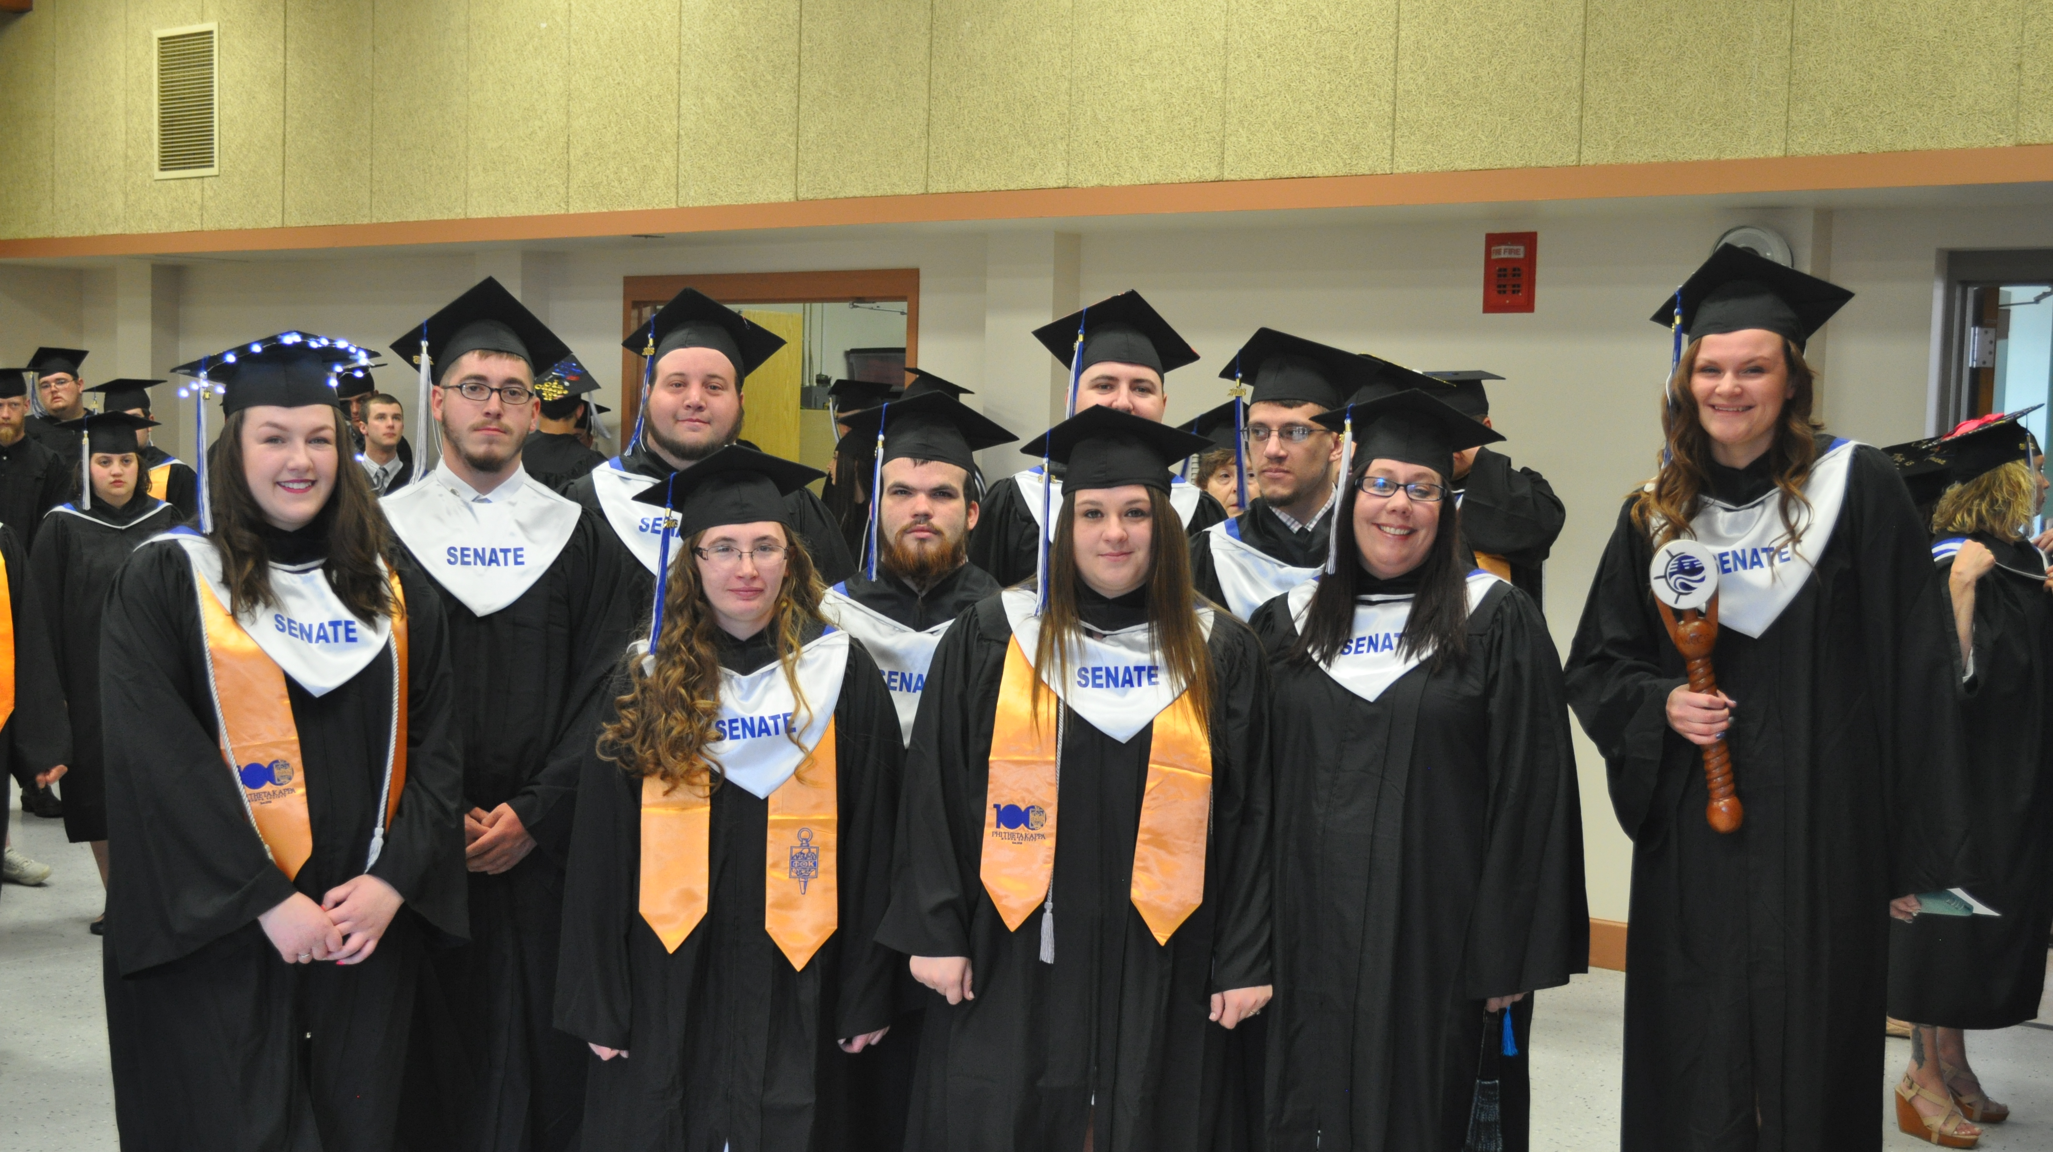
Fulfilling Our Academic Mission
Creating outdoor classrooms and spaces
Library invested in electronic books and resources 150,000+
Brightspace
Access Hubs
Drive-In Wi-Fi

Slide 8
Fulfilling Our Academic Mission

Slide 9
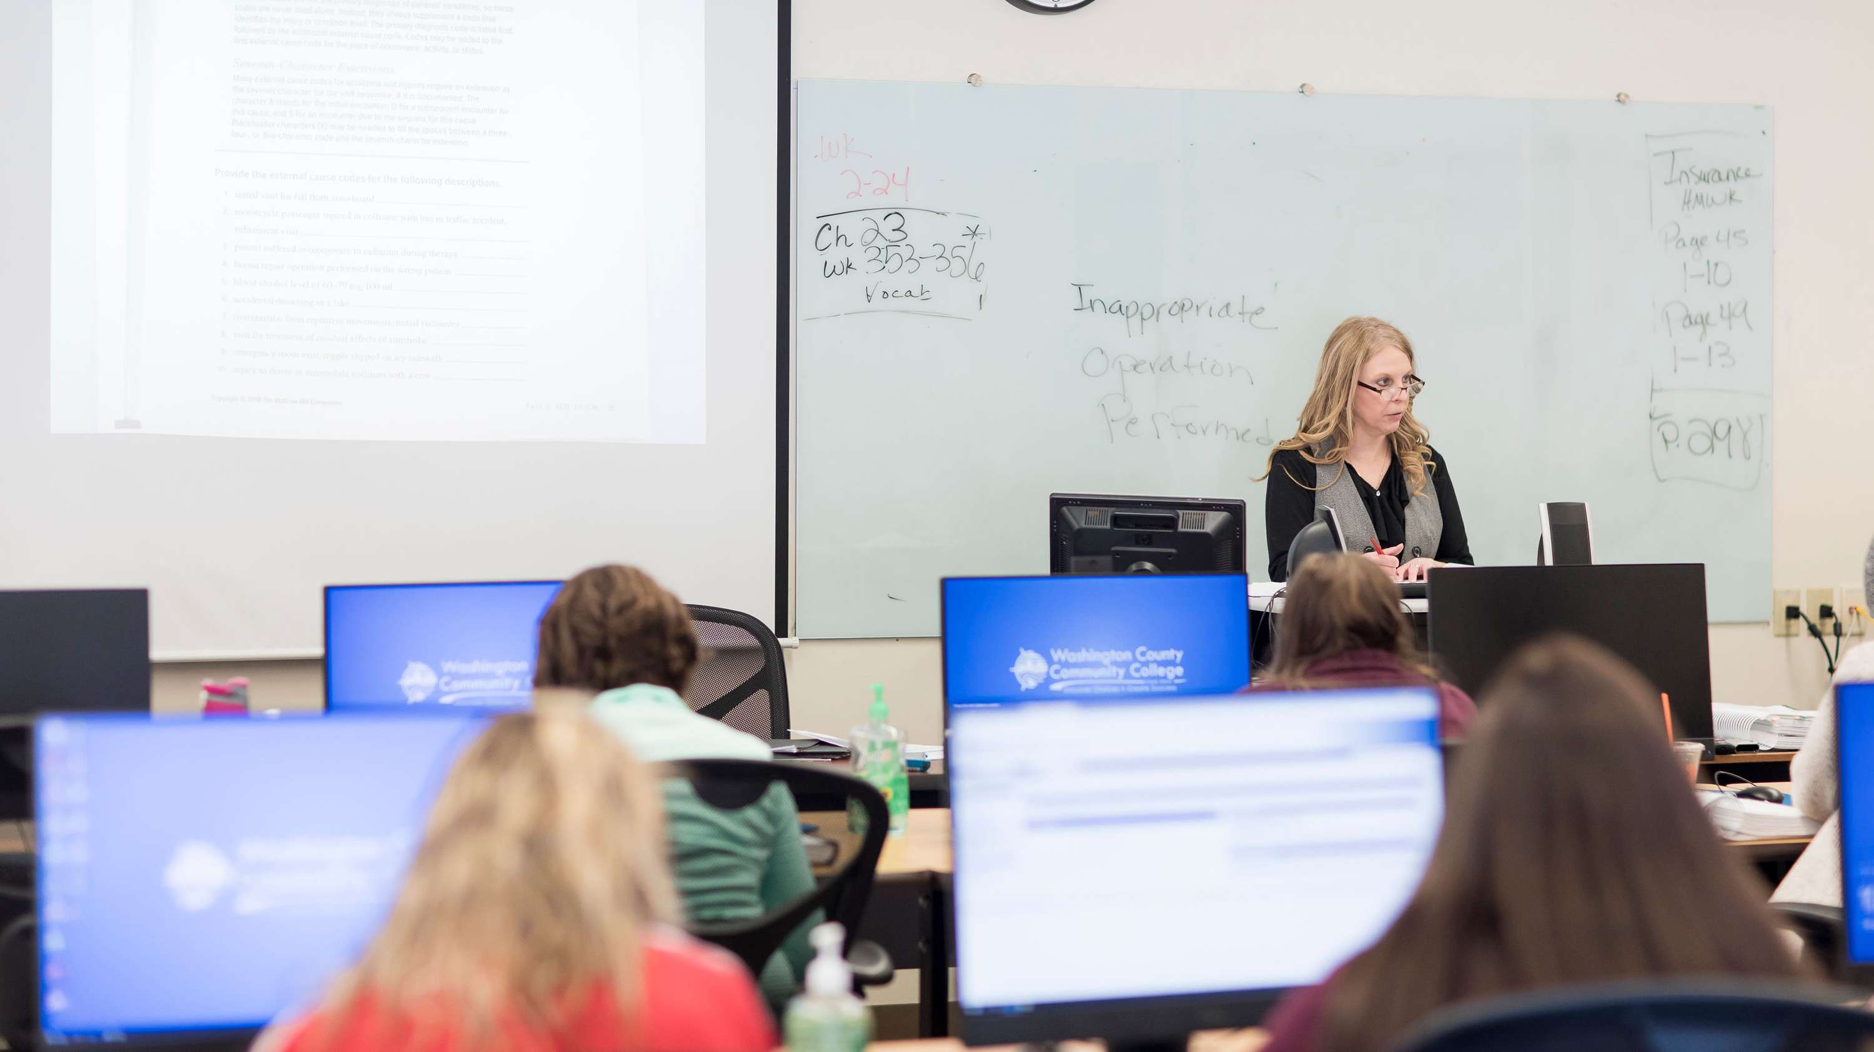
Fulfilling Our Workforce Mission
Best Practices—virtual platforms
Workforce and Industry Outreach
Hybrid model for Certified Nursing Assistant
Commercial Fisheries & Marine Technology
National Certification Testing

Slide 10
Listening & Communicating: Fostering Community
Established COVID-19 site and email
Communication protocols
Hosting student and family sessions
Educational and training videos
Signage in bathrooms and residence hall rooms (handwashing, face cloth masks)
Eagles Soar student educators
Employee checklist and Keep Our Workplace Safe

Slide 11
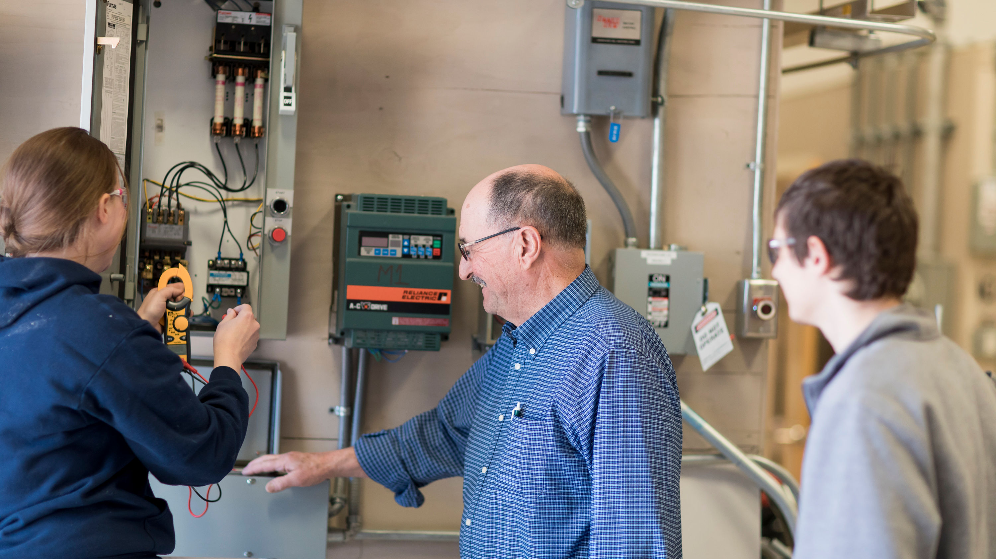
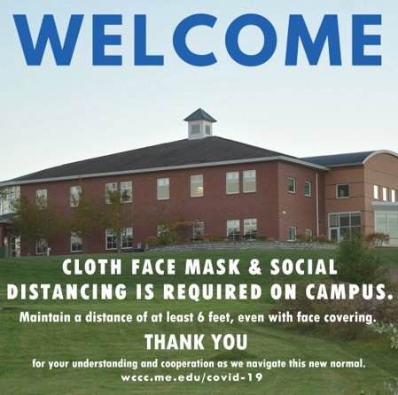
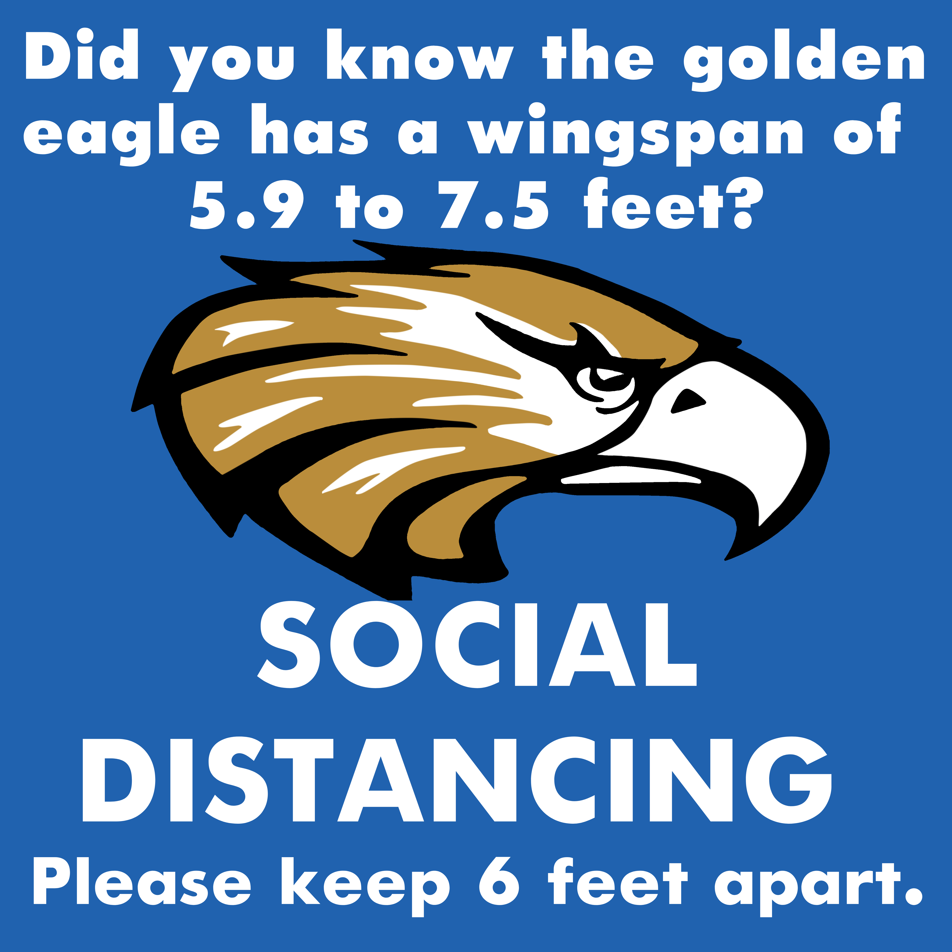
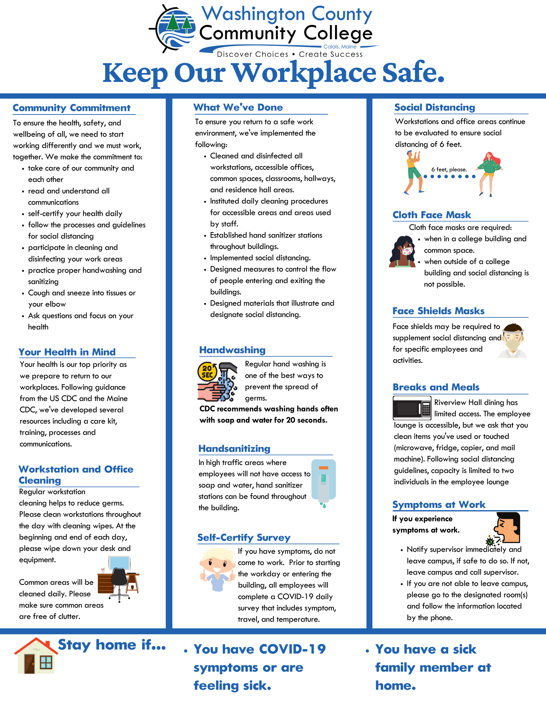
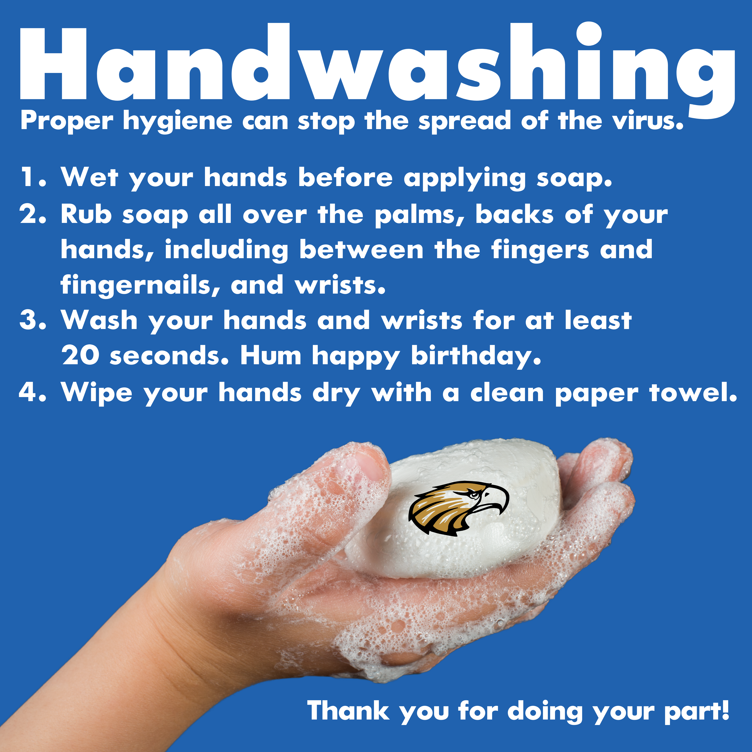
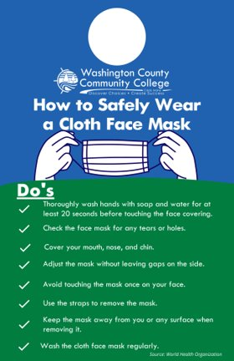
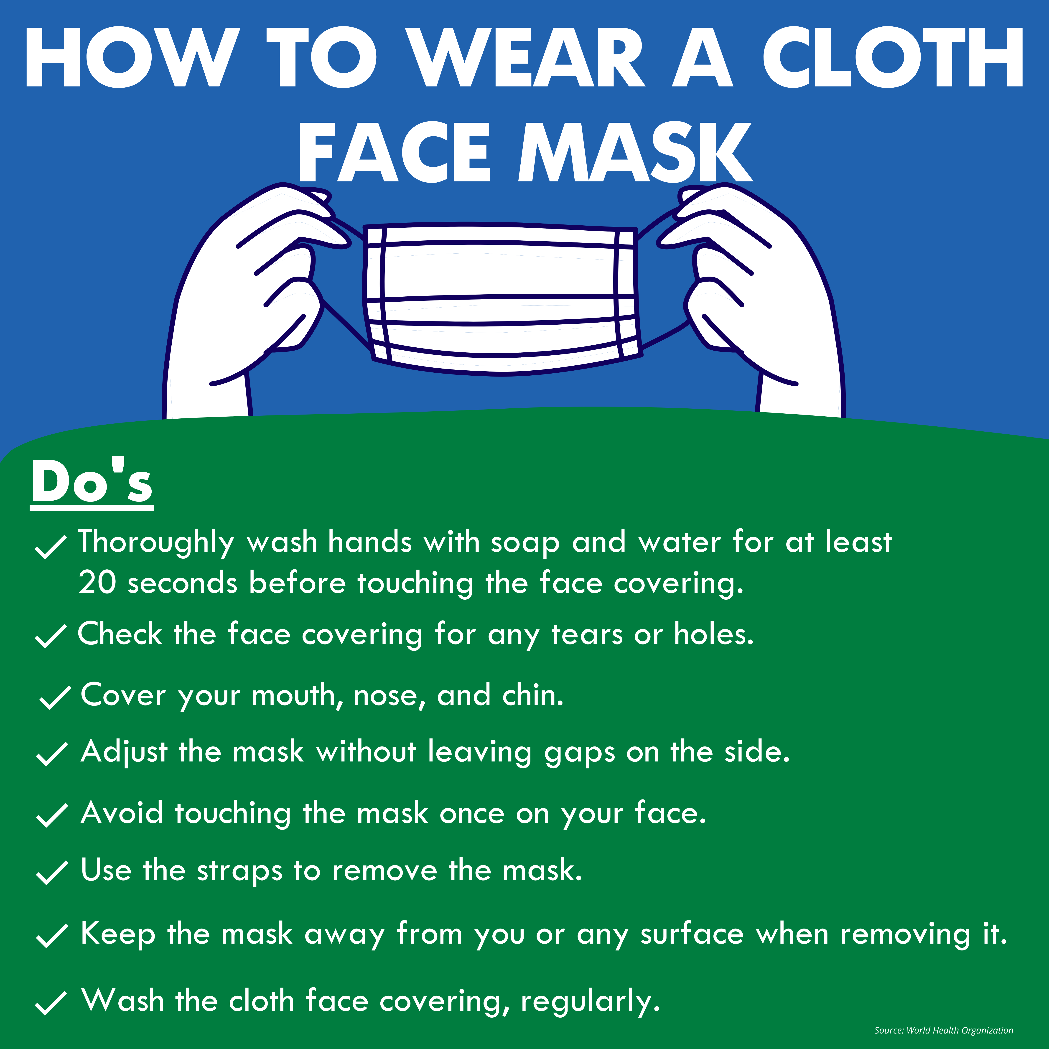
Listening & Communicating: Fostering Community

Slide 12
Fulfilling Our Student-Centered Mission
Student support services (TRIO, JMG, Student Navigator)
Investing in technology to deliver 24/7 tutoring
Counseling and mental health expansion
Caring Cupboard operations
Outdoor and virtual co-curricular activities

Slide 13
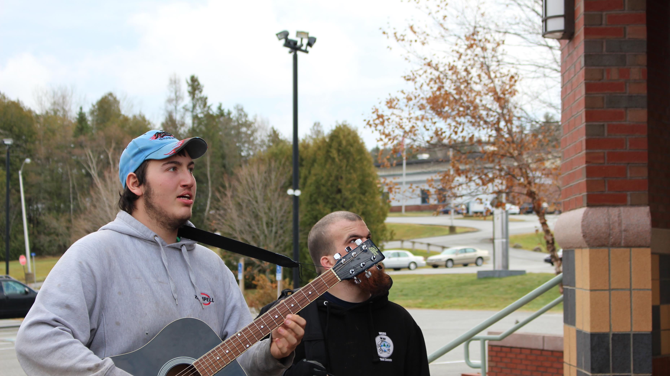
Fulfilling Our Student-Centered Mission
Increased use of technology to provide academic and support services and community relationship building
Strengthened mentor program
Cross-functional training for services and operations
MyWCCC self-service

Slide 14
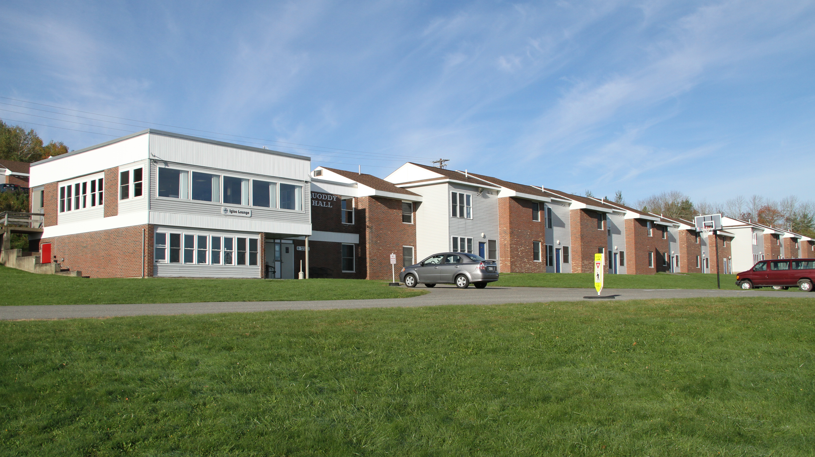
Supporting Our Residents
60% capacity with placements based on priority
Students are housed by courses, first, then major
Reduced access to apartments and common areas
Increased healthy and safety checks
Created virtual and outdoor programs
Incentives to remain on campus
Quarantine and isolation procedures
Dining Services

Slide 15
Cunning, intelligent, and bold—they are fierce and strong.
AND WE SOAR, together.

