Slide 1
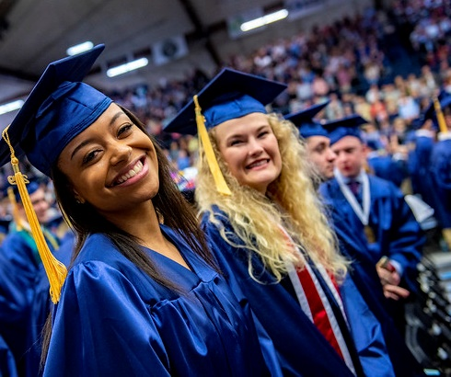
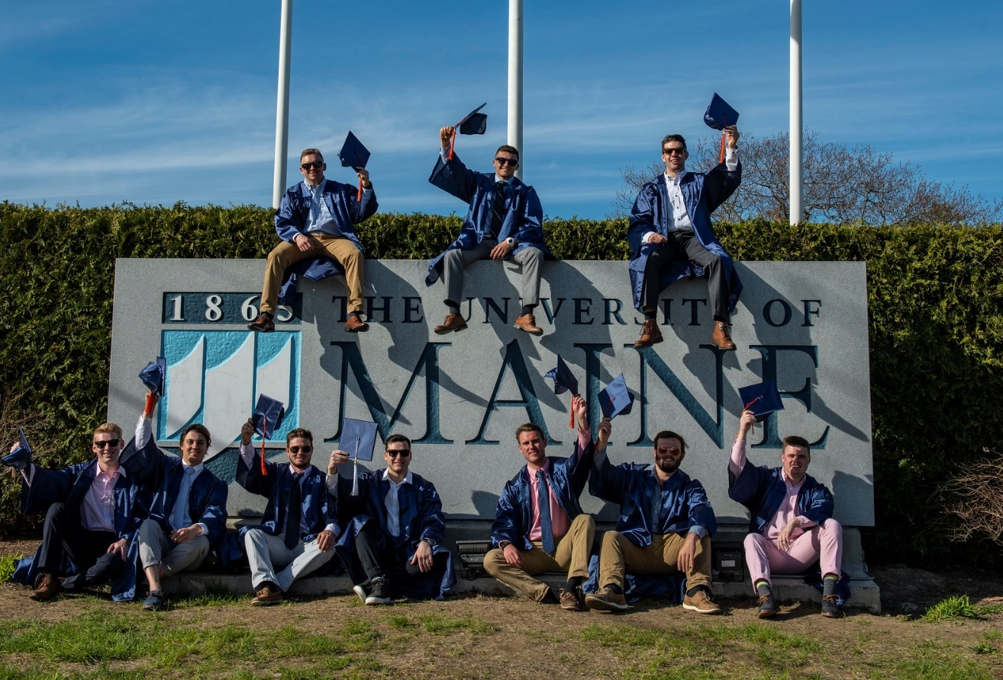
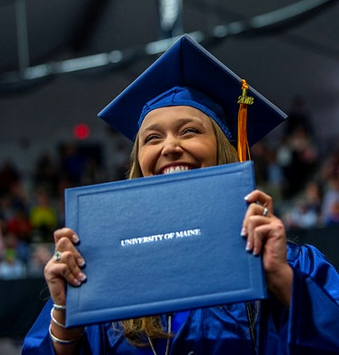
Improving Student Success at the University of Maine
Jeffrey E. Hecker
Executive Vice President for Academic Affairs and Provost

Slide 2
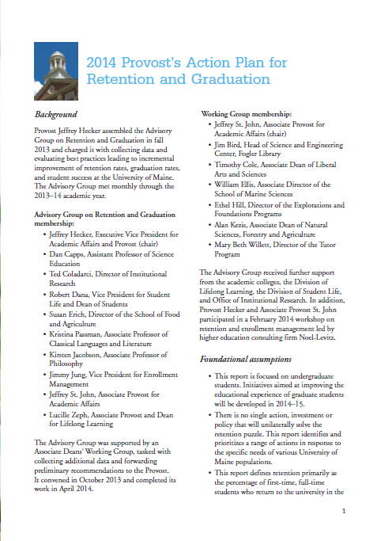
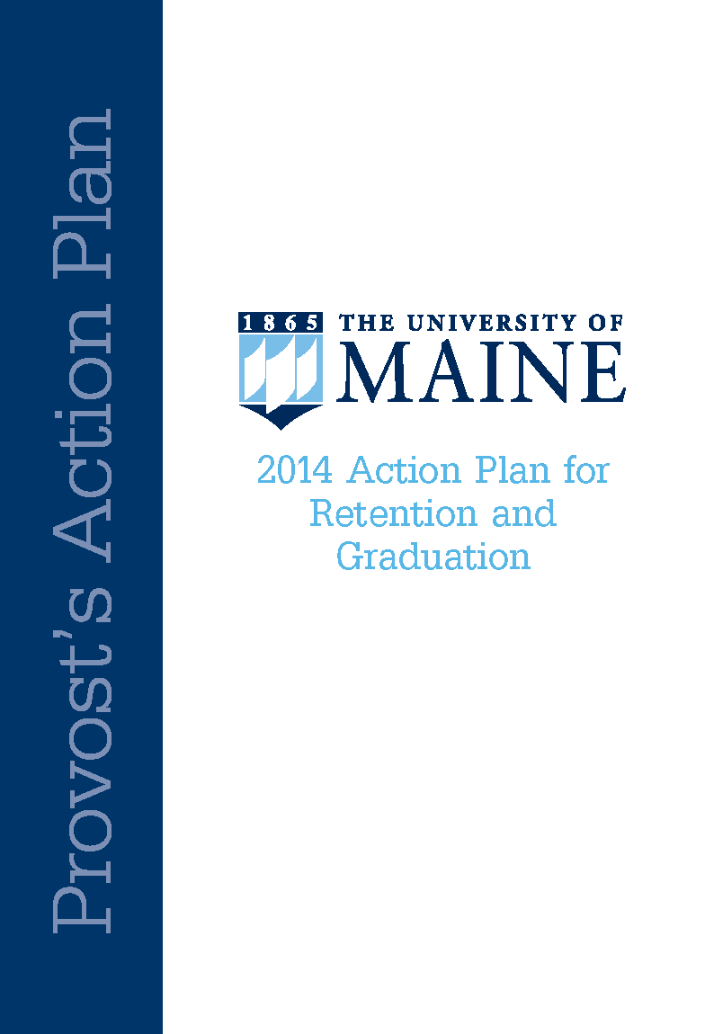
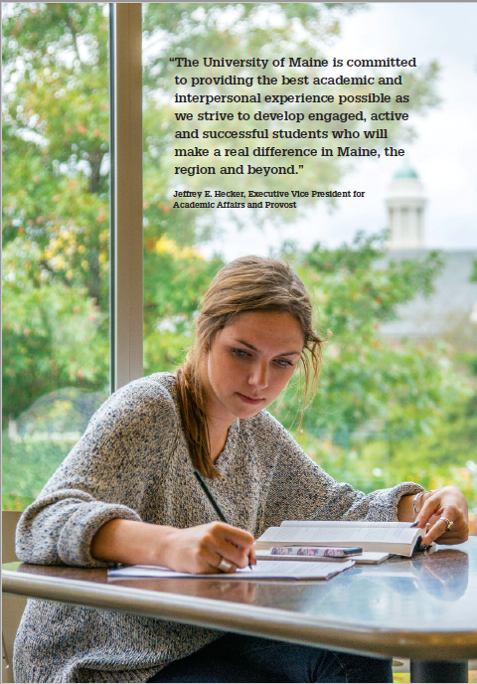
Groundwork
UMaine undertook a year-long examination of undergraduate retention and graduation in 2013-14, bringing together Academic Affairs and Student Affairs to look closely at our data, practices, and outcomes.
Notes:
UMaine undertook a year-long examination of undergraduate retention and graduation in 2013-15, bringing together Academic Affairs and Student Affairs to look closely at our data, practices, and outcomes.
One of our chief conclusions was that we needed to improve our four- and six-year graduation rates. The Think 30 initiative is at the heart of our response to that challenge.

Slide 3
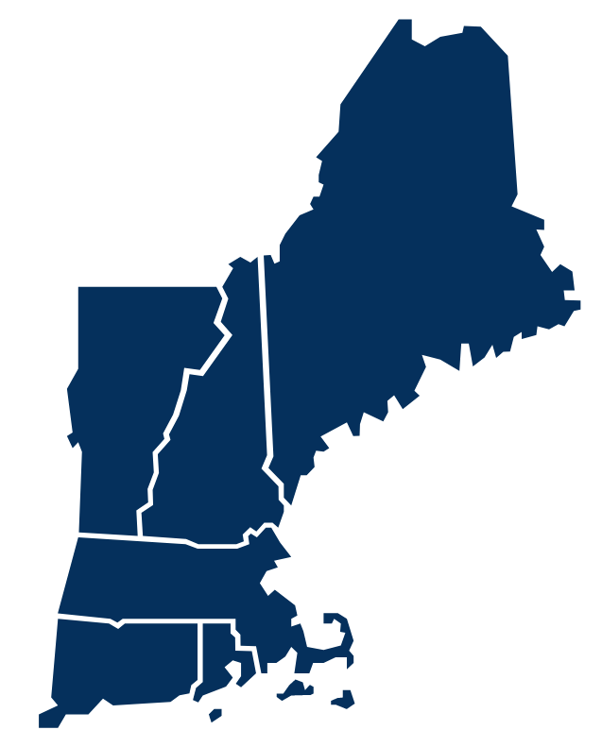
Key Finding: Our Competitors
Fall 2009
We ranked below our aspirational peers – the other New England land grants.
4-Year Graduation Rates
6-Year Graduation Rates
Notes:
The four-year graduation rate for our Fall 2010 cohort was 36%. The six-year graduation rate for that cohort was 59%. In both measures, we rank below our fellow New England land grants and our aspirational peers.
In 2014-15, the required fall and spring undergraduate load for full-time status—and eligibility to receive institutional aid—was 12 credits. This meant that students carrying an average load in fall and spring who did not also enroll in at least one summer course earned fewer than 30 credits over their first year of study.
We knew we had to do better.

Slide 4
Key Finding: Debt & Time to Completion
78%
54%
Average Debt for Typical UMaine Graduate
Graduation Years
Average Student Debt as of June 2018
$20,470 $31,523 $36,395
Notes:
The average debt for a typical UMaine graduate increases by 54% when he or she finishes in five years instead of four. For those who graduate in six years, it's 78% higher.
As of June 2018, the average student debt for a Maine resident graduating from UMaine in four years was $20,470. For those graduating in five years, that figure rose to $31,523. For students graduating in six years, it was $36,395.

Slide 5
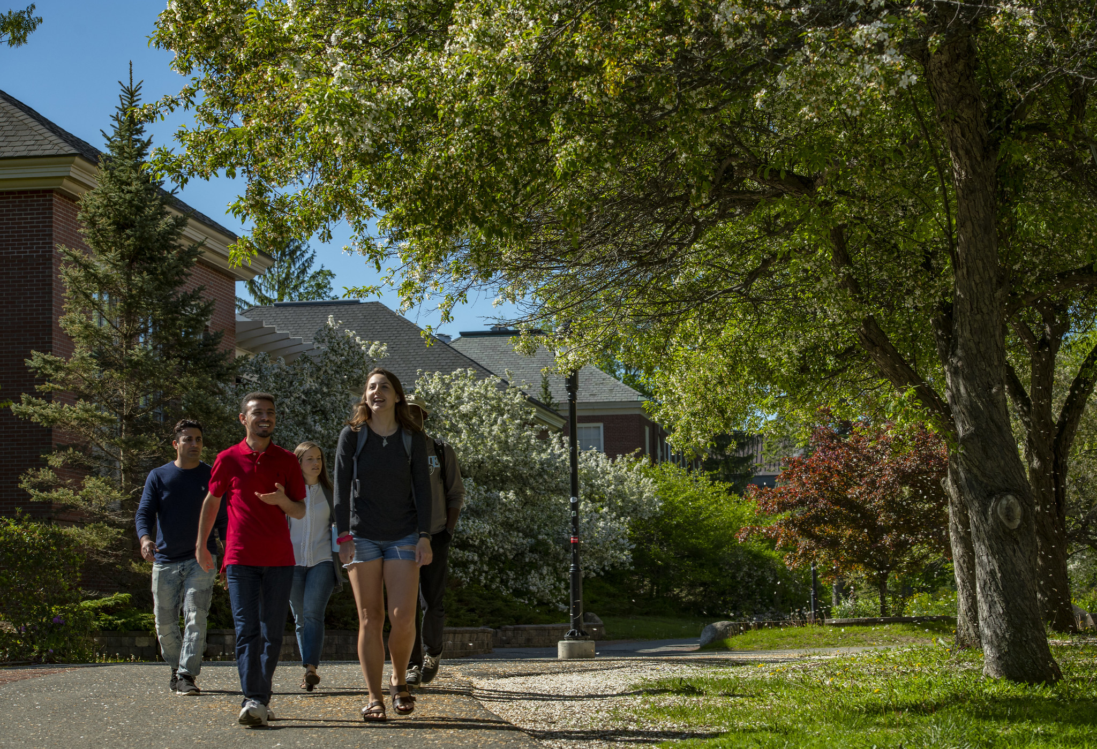
Key Finding: Advising Challenges & Misconceptions
“Its best for students to start with a lighter load their first year. They can always catch-up.”
“Take your time to explore courses in your first couple of years.”
Dropping courses with no plan to catch up
No advise

Slide 6
Key Finding: Course Conflicts & Course Repetition
Impossible for students to get courses they needed when they needed them because they were offered at the same time as other courses they needed.
High rates of repeating courses
Minimal opportunities to “catch up”

Slide 7
Key Finding: Financial Incentives not Aligned with Goals
Student receive immediate financial reward for dropping classes.

Slide 8
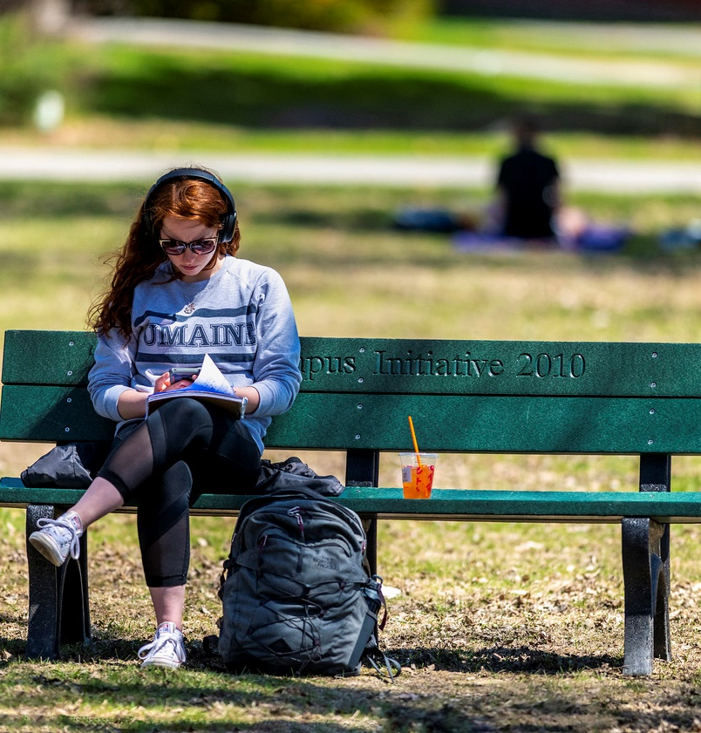
The Opportunity
About 67% of Maine students who completed 30 or more credits before their second year graduate in 4 years.
Many students who earned fewer than 30 credits in their first academic year fell short by only one or two courses.
Students and faculty unaware of financial consequences of longer time to graduation.
Notes:
Roughly two-thirds of UMaine students who complete 30 credits or more before their second year of study graduate in four years.
Many students who earn fewer than 30 credits in their first academic year fall short by only one or two courses. A single winter or summer course can make the difference in putting students on track to graduate in four years and keeping them there.

Slide 9
The Strategy
Complete College America – “Fifteen to Finish"
Application to UMaine
High number of students work
High levels of course repetition
Develop an initiative that focuses 12 month calendar year as opportunity to earn thirty credit hours.
Notes:
Believing that a "fifteen to finish" emphasis on the fall and spring semesters was not the right approach for our population, we decided to look strategically at the full calendar year. We concluded that we were underutilizing our Summer University session and making no use at all of the interval between fall and spring.
We became convinced that if made targeted changes to our academic schedule and financial aid practices and marketed Think 30 effectively, we could improve outcomes for our students.

Slide 10
The Initiative
Public Awareness Campaign
Advisor Training
Improve scheduling to reduce conflicts
Align incentives with goals
Notes:
The main goal of Think 30 is to increase the number of students who complete 30 credits per year and graduate on time in four years with lower debt loads and reduced opportunity costs.

Slide 11
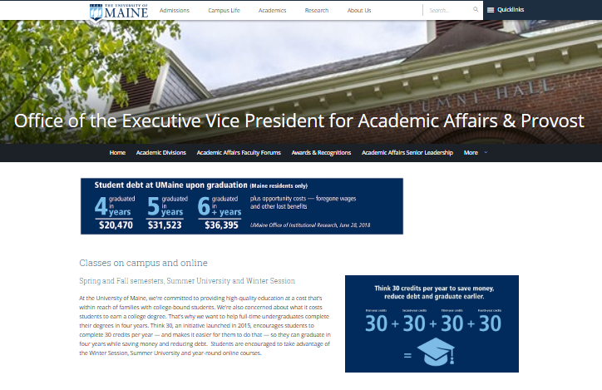
Public Awareness: Laying the Groundwork
Marketing & Communications team designed a Think 30 logo and website
Institutional Research & Assessment provided data for a "fast facts" postcard.
During Summer and Fall 2015 postcards were sent to admitted and matriculated students, parents, faculty, staff, and administrators.
Crash-course on Think 30 and its objectives for all staff working New Student Orientation in summer 2015.
Notes:
Our Marketing & Communications team designed a Think 30 logo and website, while Institutional Research & Assessment provided data for a "fast facts" postcard.
We blanketed the campus with the postcard in Summer and Fall 2015, sharing it with admitted and matriculated students, parents, faculty, staff, administrators. We also offered an informal crash-course on Think 30 and its objectives for faculty, associate deans, and Admissions staff working New Student Orientation that summer.

Slide 12
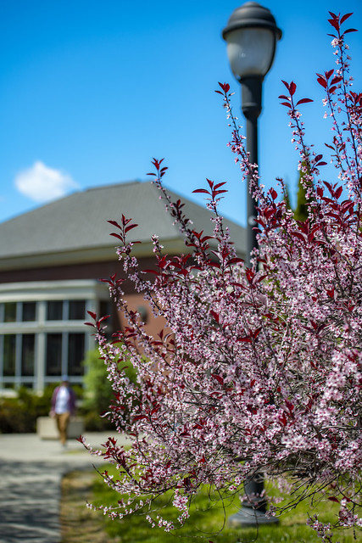
Communicating with Key Constituencies
In 2015-16, Academic Affairs leadership team discussed Think 30 with
Faculty Senate
Deans
Associate Deans
Provost's Council
Chairs and Directors
Faculty and Staff campus wide
Leaders in Student Affairs shared Think 30 with
Student Government and other student organizations
By Fall 2016, a basic understanding of Think 30 and its aims was widespread among faculty, students, and staff.
Notes:
In 2015-16, my leadership team and I discussed Think 30 with our Faculty Senate, deans, associate deans, Provost's Council, chairs and directors, staff, and faculty campuswide. Leaders in Student Affairs also shared Think 30 information with student government and other student organizations.
By Fall 2016, a basic understanding of Think 30 and its aims was widespread among faculty, students, and staff.

Slide 13
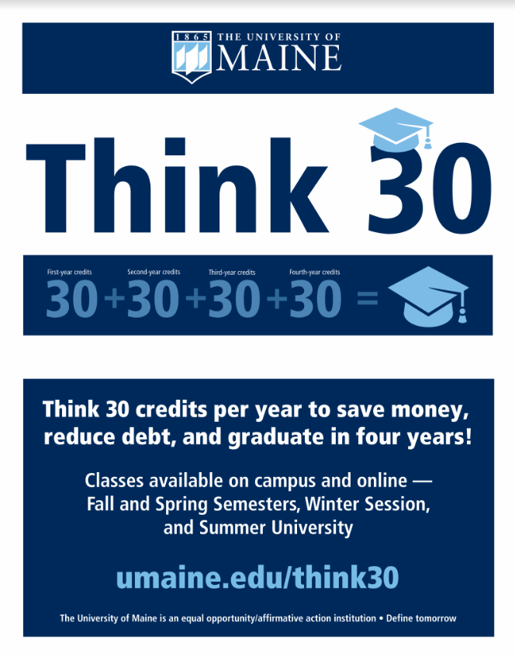
Public Awareness: Marketing Campaign
Division of Lifelong Learning has been the lead in saturating the campus with marketing collateral, including banners, signs, digital ads, table toppers, and video and email campaigns.
Think 30 materials featured at
Accepted Student Days
Admissions Open Houses
campus tours
school group tours
other campus visits/events
Notes:
Beginning in 2015-16, Lifelong Learning saturated the campus with marketing collateral, including banners, signs, digital ads, table toppers, and video and email campaigns.
Think 30 materials were featured at Accepted Student Days, Admissions Open Houses, campus tours, school group tours, and other campus visits/events.

Slide 14
Public Awareness Campaign
Think 30

Slide 15
Scheduling
Winter Session
Summer Session
Course Scheduling

Slide 16
Scheduling: Reviving Winter Session
DLL relaunched in 2015-16
Offering 20 high-demand undergrad courses
3-week fully online session
Attrition has been low
Academic outcomes have been strong
Winter Session Enrollment 2016-19
Notes:
In 2015-16, our Division of Lifelong Learning relaunched UMaine's Winter Session, offering 20 high-demand undergraduate courses taught by experienced online instructors in a three-week, fully online session.
Our enrollment target that first winter was XXX. Our actual enrollment was 687. Winter Session enrollment grew to 957 in 2017, 1,219 in 2018, and 1,263 in 2019. Attrition in most Winter Session courses has been low, while academic outcomes have been strong.

Slide 17
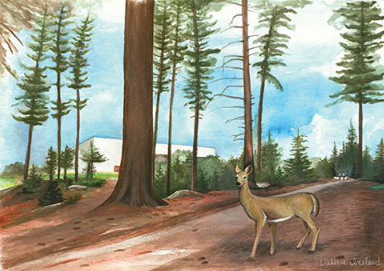
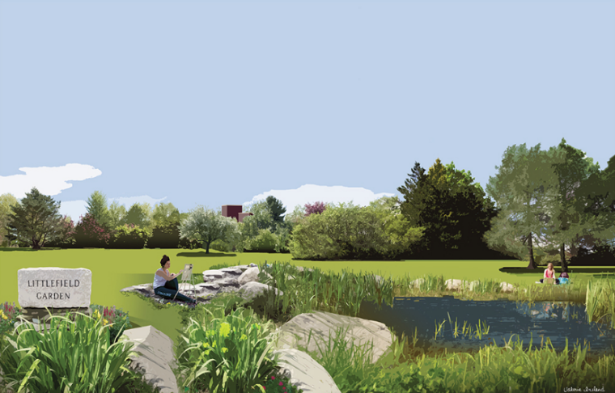
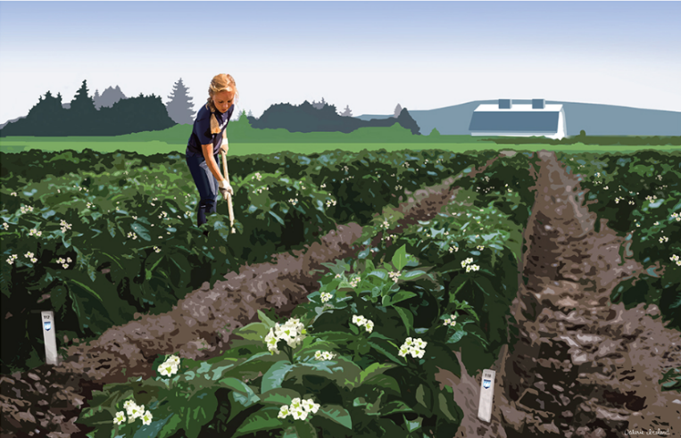
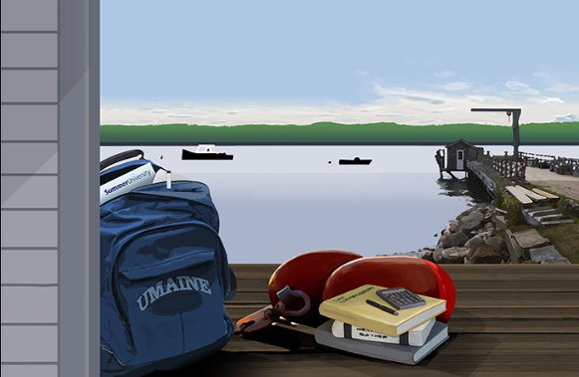
Scheduling: Restructuring Summer University
DLL retooled and simplified Summer University schedule
Reduced the number of sessions
Increased the number of online courses available
Changes led to increased enrollment and changes in enrollment patterns
Notes:
In 20XX, Lifelong Learning retooled and simplified the Summer University schedule, reducing the number of sessions from XX to XX and [Monique: different offerings, different marketing, etc.].
These changes led to [improved enrollment; changes in enrollment patterns; etc.].

Slide 18
Scheduling: Infosilem
Infosilem is a course scheduling software application.
- Optimize use of time and space in building course schedule
- Minimize course conflicts scheduling
Fall 2015 – last pre-Infosilem semester to Fall 2018 semester there was a 90% decrease in course scheduling conflicts for students

Slide 19
Aligning Incentives
Federal definition “Full-time”
12 credit hours per semester
12 credit hours
X
2 semesters
30 credit hours
Common Scenario
Student starts semester with 15 credit hours.
Student drops a course in add/drop period.
Student receives a refund of tuition.
Student is happy and in short run (cash in pocket).
Student is less happy in long run (more student debt, lost wages).
Student receives financial aid package that includes federal funds, state funds, and institutional funds.

Slide 20
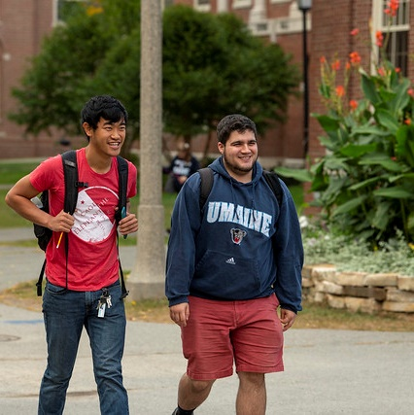
Changing “full-time” Status
Starting in Fall 2016, we began to prorate institutional aid if students took fewer than 15 credits.
Students may apply the “lost” aid to the cost of the subsequent summer’s tuition and fees.
Notes:
Changing "full-time" status
Starting in Fall 2016, we increased the fall and spring load required for students to receive institutional merit aid from 12 to 15 credits . Along with Winter Session and the changes to Summer University, this shift has been a significant reason for the increase in students completing 30 credits per year.
Possible revised language for first sentence: Starting in Fall 2016, we began to prorate institutional aid if students took fewer than 15 credits. Students do have the option of applying the prorated aid to the cost of the subsequent summer’s tuition and fees.
This might be confusing because the definition of full-time is still 12 credits. Students can still receive aid, it is just prorated.
See possible revised sentence below.

Slide 21
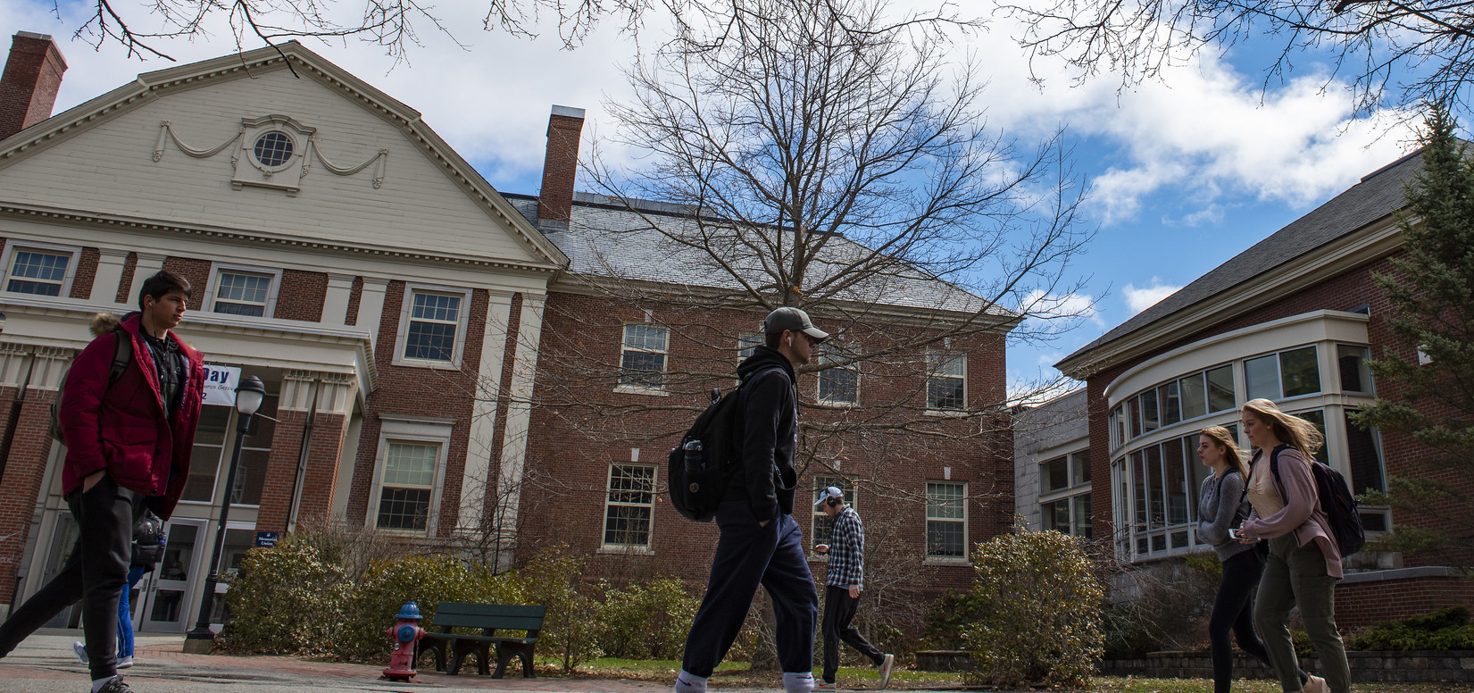
Think 30: Preliminary Outcomes
2nd Year Returning
Students
3rd Year Returning
Students
First-time Students
83% of first time, full time students attempted 15 or more credits in their first semester, up 23 percentage points.
Full-time cohort, 74% began the year with 30 or more credits, up nine percentage points.
The percentage who had attempted 30 or more credits in their second year credits rose 10 percentage points.
Fall 2015 versus Fall 2018
Notes:
In fall 2018, 83% of first time, full time students attempted 15 or more credits in their first semester, up 23 percentage points from fall 2015.
Of students returning in 2018 from the fall 2017 first-time, full-time cohort, 74% began the year with 30 or more credits, up nine percentage points from the 2015 cohort. Among students returning for their third year, the percentage who had attempted 30 or more credits in their second year credits rose 10percentage pointsfrom Fall 2016 to Fall 2017.

Slide 22
Preliminary Outcomes: Four Year Graduation

Slide 23
Four Year Graduation – 1986 through 2014

Slide 24
Challenges & Unintended Consequences
Unintended Consequences
Challenges
Financial Aid Policies
Faculty Buy In
Student Buy In
Proliferation of one credit hour courses
Students initiate Think 30 discussions
Notes:
We worked through a series of administrative steps to reinstitute Winter Session, mainly involving financial aid and the relationship between Winter Session and spring semester. We also grew Winter Session incrementally to avoid sudden drops in spring enrollment.
One unintended consequence of Think 30 was that our undergraduate advising culture had to change. Many departments have formally or informally adjusted their advising practices in view of the shift from a 12-credit to a 15-credit full-time load.

Slide 25
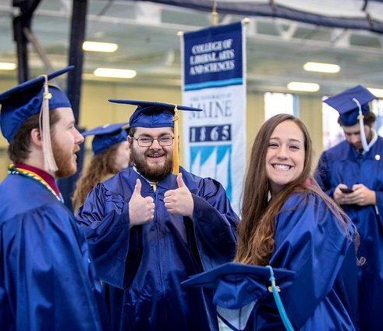
Future
First Year Student Success Initiative
Notes:
1. Our students have responded positively to a structured path to timely graduation reinforced by institutional practices and clear expectations.
2. A strong majority of faculty and staff have supported the changes we've made to our academic practices because they have seen those changes bear fruit for their students.
Others

