Slide 2
Thank You
Tony Jones, MEMIC
Dr. Beth Collamore, Medical Advisor
Campus Safety Committee
Maine Community College System
Other Community College in the MCCS
NMCC Employees
NMCC Students
NMCC General Advisory Council

Slide 3
NMCC REOPENING PLAN
Our Reopening Plan was built upon two Guiding Principles
Providing a safe working and learning environment for students and employees
Providing quality instruction to students in a manner that continues the level of
engagement upon which students expect

Slide 4
Four Topics to Share
COMMUNICATION
ACADEMIC
STUDENT SERVICES
CHALLENGES AND FUTURE PLANNING

Slide 5
Communication Strategies
What we have done and who has been involved
Local Health Care Providers –
COVID-19 Planning Group – Met weekly beginning 1st week of April to coordinate planning and needs, assess area resources, facilitate communications & develop relationships, sharing contact information, and sharing of resources as needed.
Four Aroostook County Hospitals
Micmac Health Services,
Maine EMS (Aroostook Division),
NMCC,
Home Health,
Maine CDC

Slide 6
Communication Strategies
Developed strategies for anticipated scenarios
One-off and group testing of asymptomatic and symptomatic individuals
Referral process re: Symptomatic individuals
Marketing materials for resources re: COVID-19 concerns/symptoms
Quarantine procedures – testing as needed
Medical Provider Liaison w/ College’s Nurse Practitioner/Health Center (available 24/7)
Needed PPE & shared contacts of PPE providers
Students return to facilities for clinical experiences/Encouragement of Maine EMS to allow student return to clinical experiences

Slide 7
Communication Strategies
Employee Meetings
Outreach to Students
Educational Partners (UMPI and UMFK)
NMCC Cabinet and Department Chairs

Slide 8
Communication Strategies
Campus-based Collective Bargaining Units
Representatives on the Campus Safety Committee
Reviewed “DRAFT” outline of Reopening Plan
Student Senate
Currently reviewing “DRAFT” outline
General Advisory Council
Shared “DRAFT” information at most recent ZOOM meeting

Slide 9
Academic Strategies
“Quality of instruction/quality of relationship with student, determines success.” Trena Soucy, NMCC Instructor

Slide 11
Academic Strategies
Early adopter of Brightspace
Student engagement for first year students
Broadcasting into 2-3 classrooms
Students access lectures from home

Slide 12
Academic Strategies
Virtual labs for life science, chemistry and physics
Schedule adjustment to reduce congestion in hallways,
dining commons, college store, etc.
Additional sections
Workforce Development Programming

Slide 13
Student Services
Residential Life
Student interactions and activities
Reed Dining Commons/College Store
Health Center

Slide 14
Residential Life
Reduced capacity:
Pre-COVID capacity: 139 beds;
COVID capacity: 50 beds
Snow and Penobscot Halls
1 resident per bedroom
Residents grouped by major and year in “suites” and “quads
Andrews Hall closed for renovations
Washington Hall repurposed for temporary quarantine space

Slide 15
Student Interactions and Activities
Theme: Less Physical Interaction
Res Hall move-in process by time slot
Only people allowed inside buildings are those who are assigned a bed
Student activities will require social distancing when in person and will include new remote/online options
Significant signage to remind residents of new social distancing norms
New protocols for RAs “on duty” to include training on sanitizing surfaces that are regularly used in the buildings
New housing contract addendum requirements

Slide 16
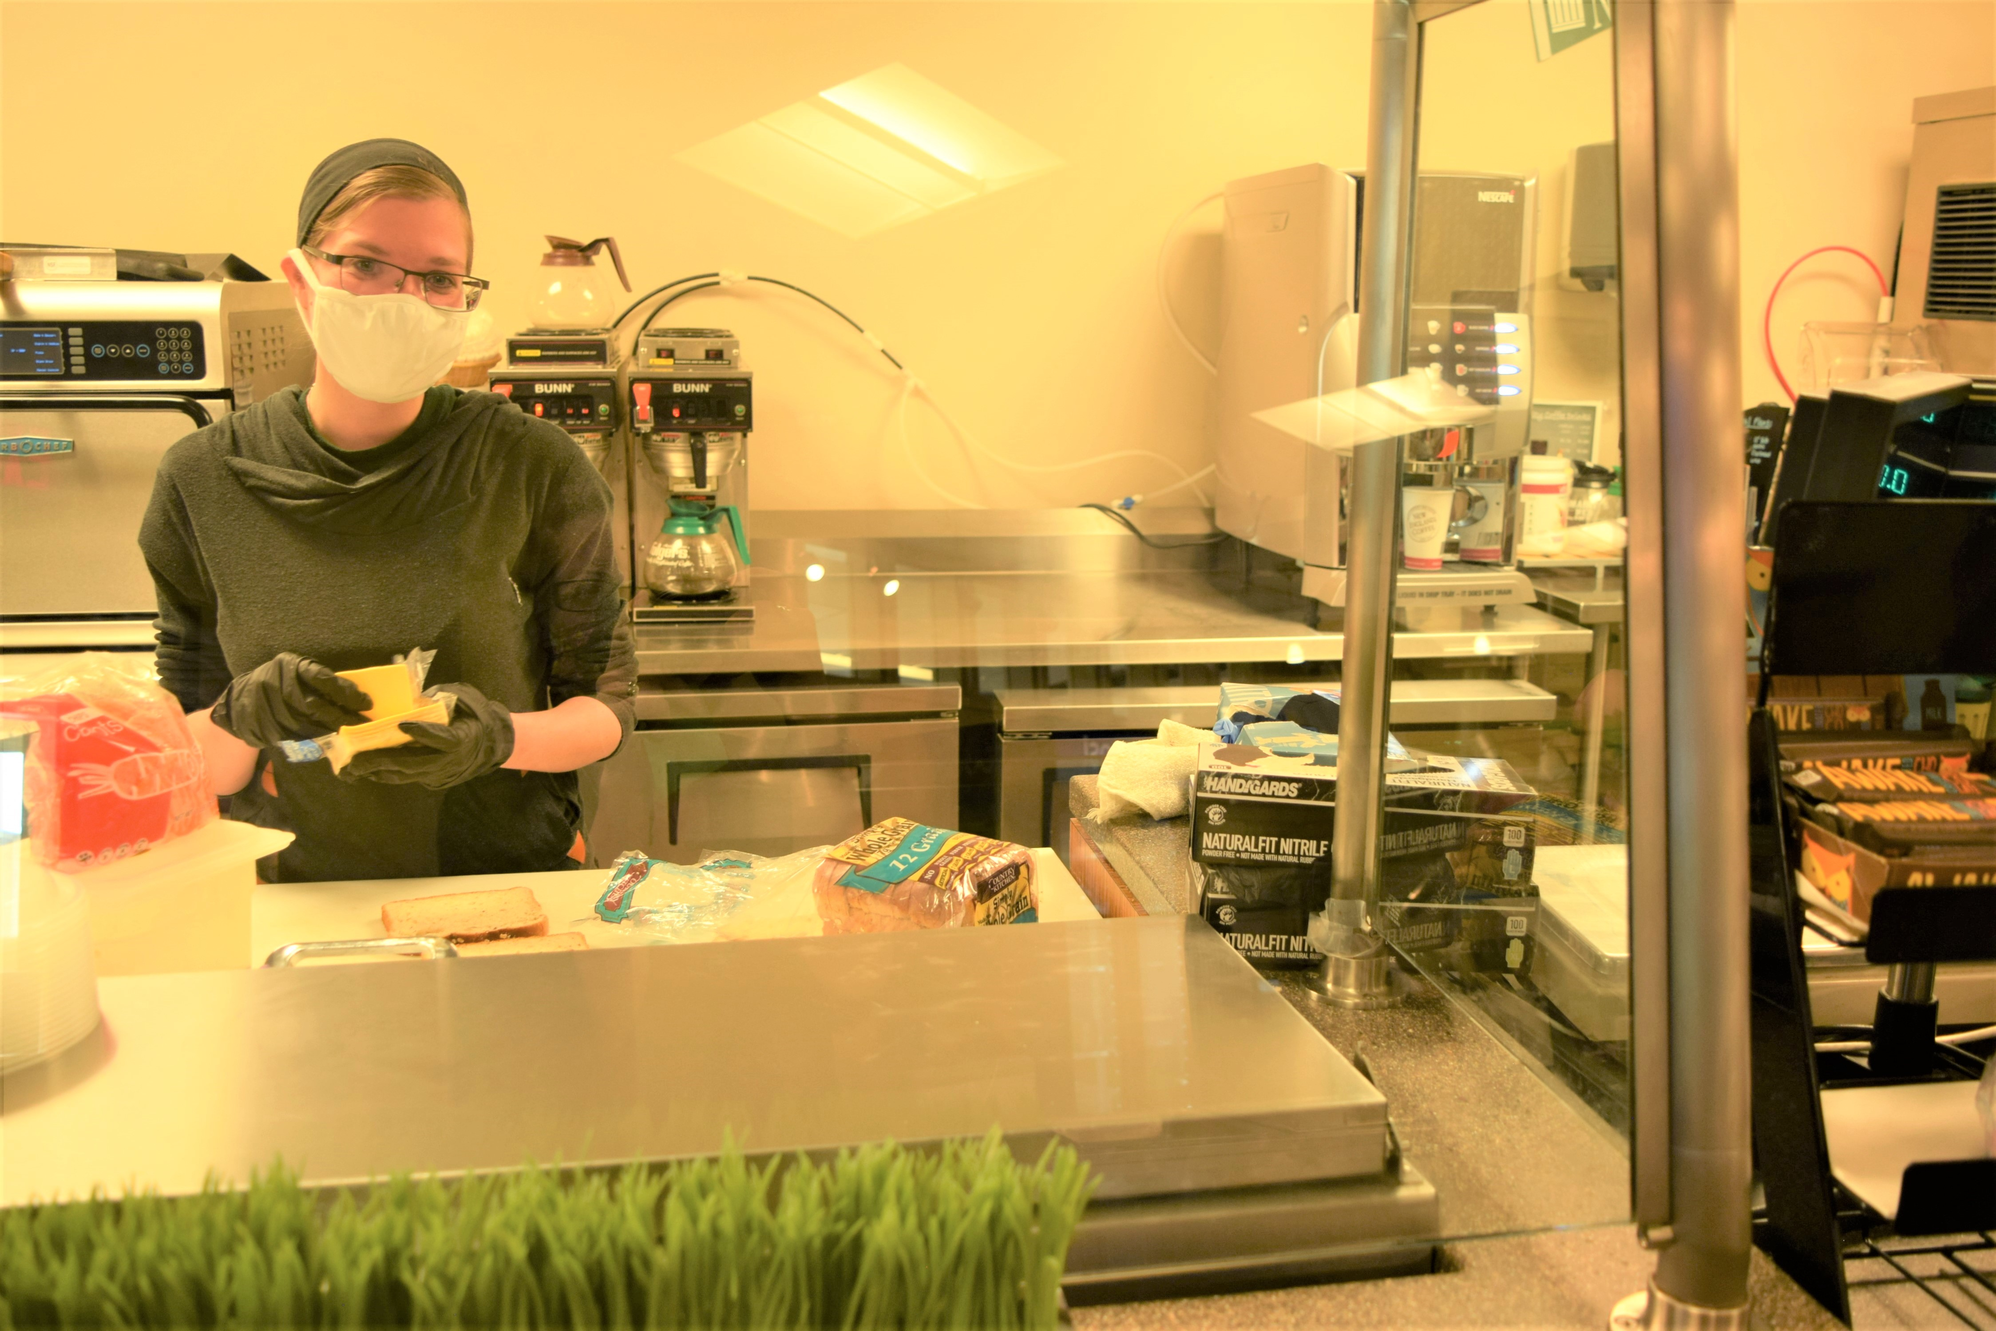
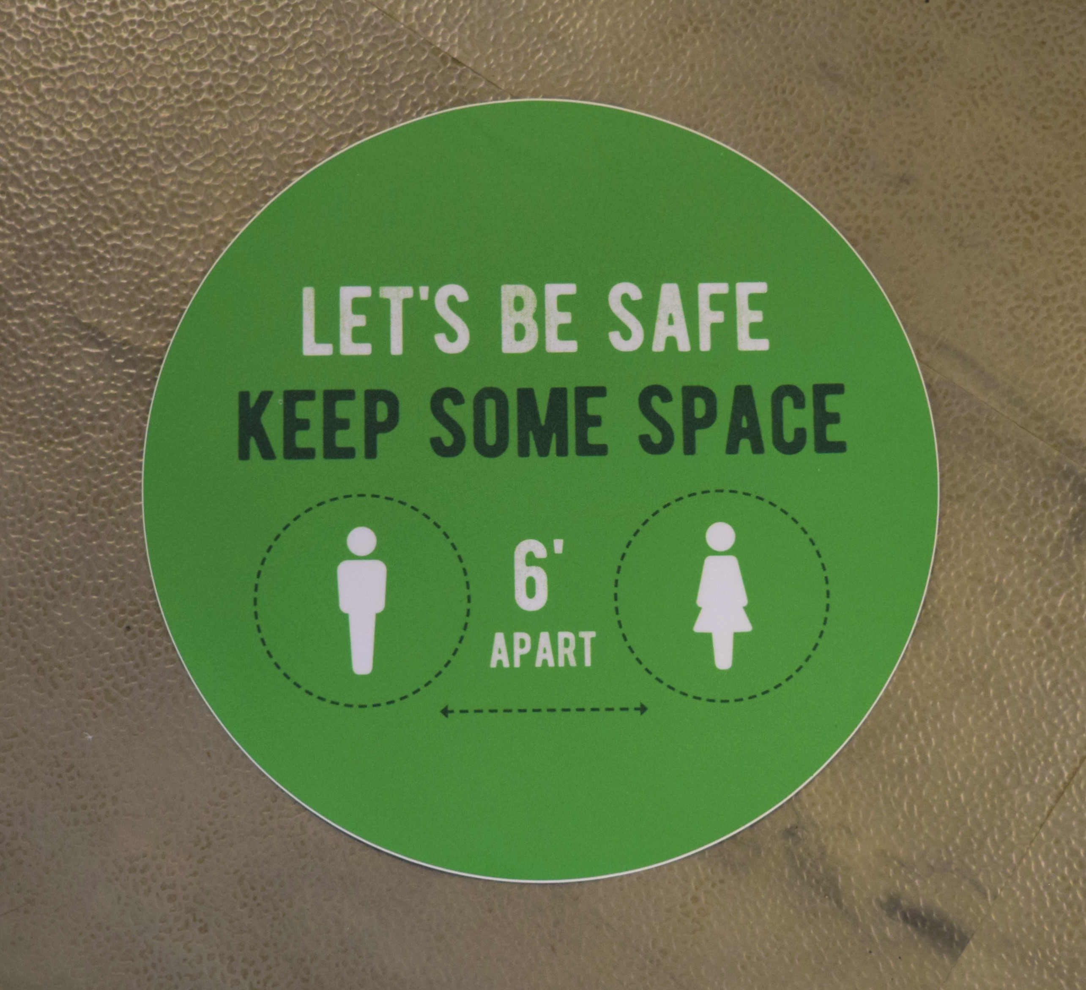
Reed Commons College Store
Food Safety
Increased sanitation practices
Suspension of self-serve buffet stations
Facility only available during dining hours
Limited seating to allow for social distancing
Use of pre-packaged utensils and condiments
To-go options available
Implementation of one-way traffic
Limiting number of patrons in the facility
Suspension of self-serve/hot food bar
Reorganization of coffee service area
Elimination of “bring your own coffee cup”
Marking of 6’ spaces for social distancing

Slide 17
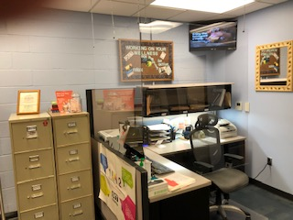
Health Center
Call ahead (walk-ins discontinued until further notice)
Pre-arrival health screening by individual and health
care provider
Pre-scheduling of appointments
Use of technology for some appointments,
if appropriate
Referral to off-campus providers, when appropriate

Slide 18
Challenges
Student Engagement
Maintaining a sense of community
Accountability
Managing fear in large geographic area
Continuing education and training
Being in sync with local partners

Slide 19
Challenges
Financial Challenges
Loss of revenue
Increased expenses
Evolving Situation
Being prepared for when the tide swings back
Determining best instructional strategies for some courses
Determining what practices and policies should remain in place

Slide 20
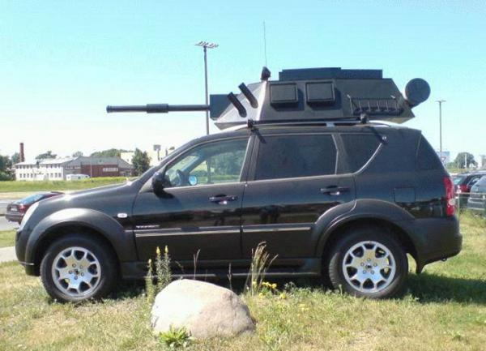
CHALLENGES
Compliance

Slide 21
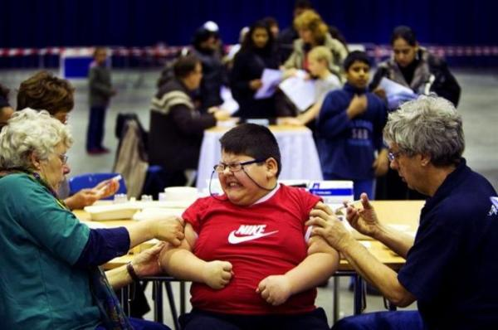
Evolution to a New Normal & Post-COVID-19
Issues to Consider – Require COVID-19 Vaccination for all Students and Staff?

Slide 22
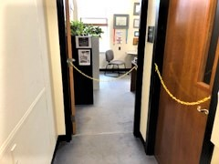
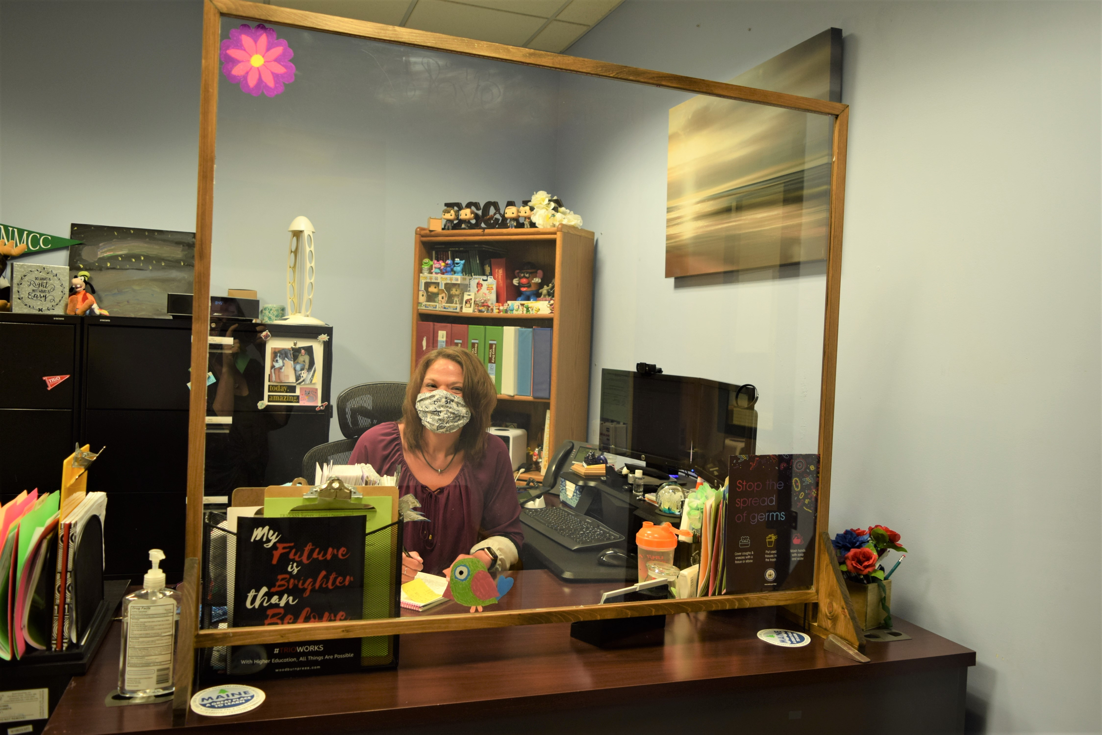
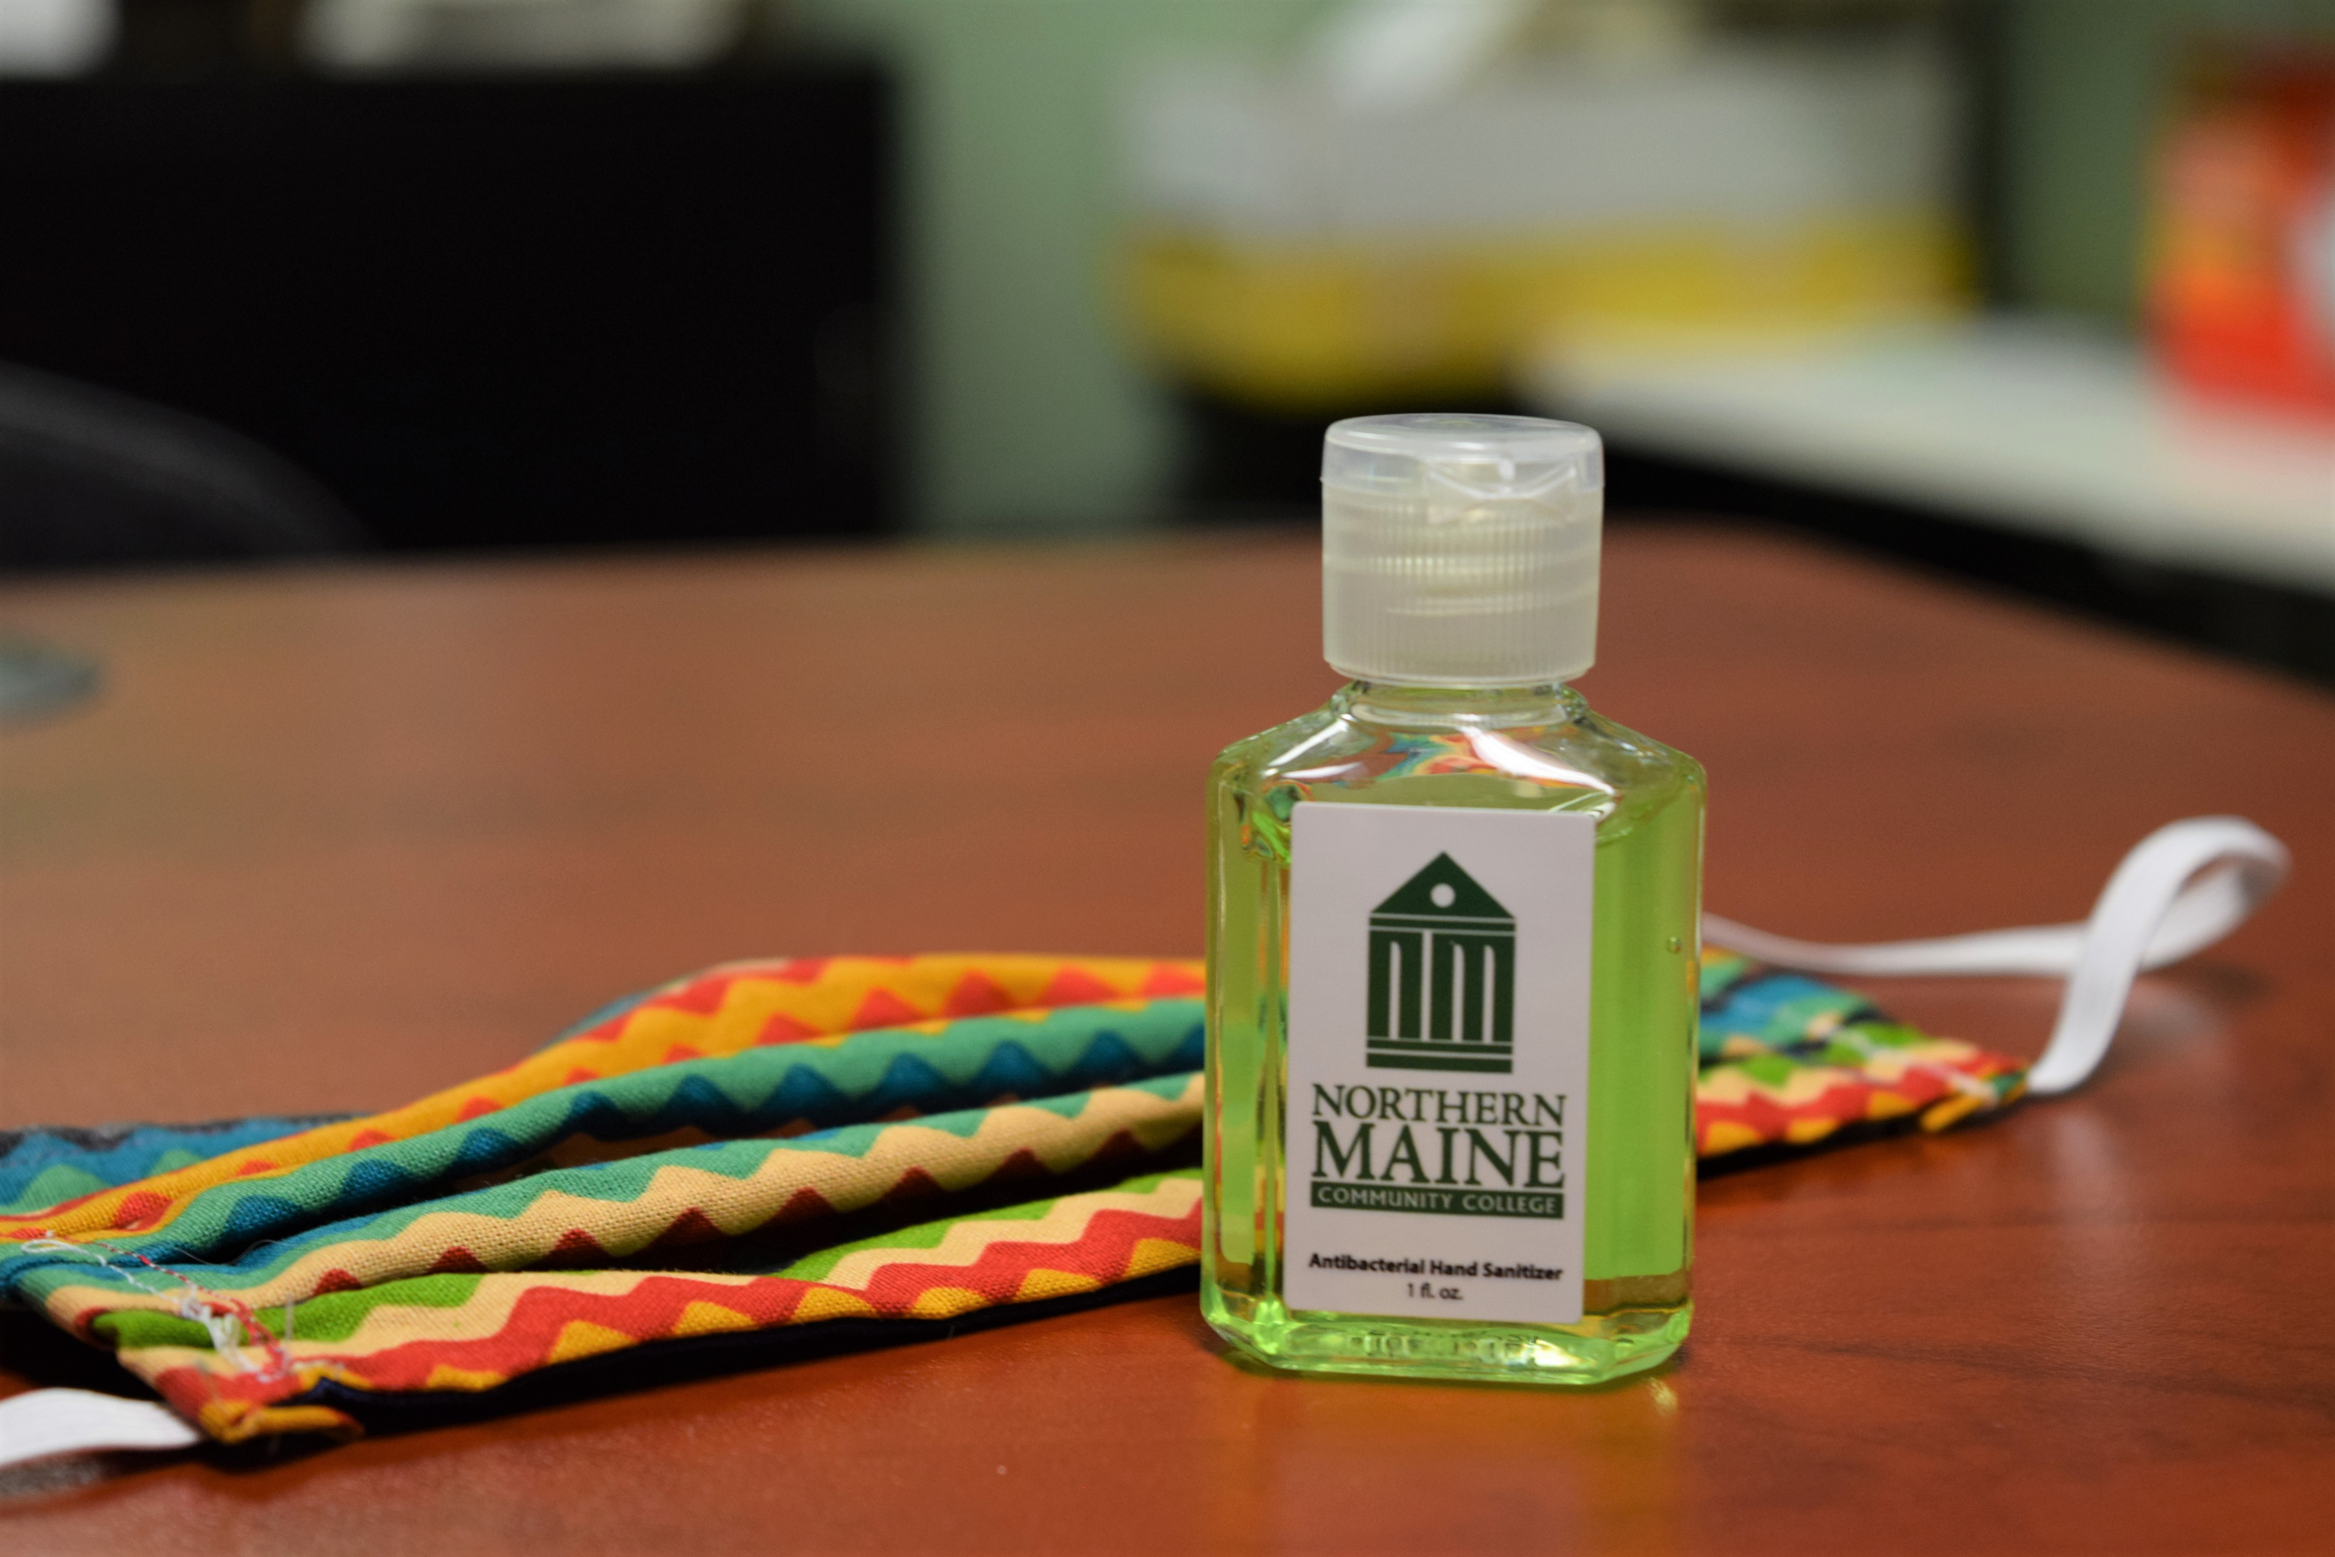
CAMPUS PHOTOS

Slide 23
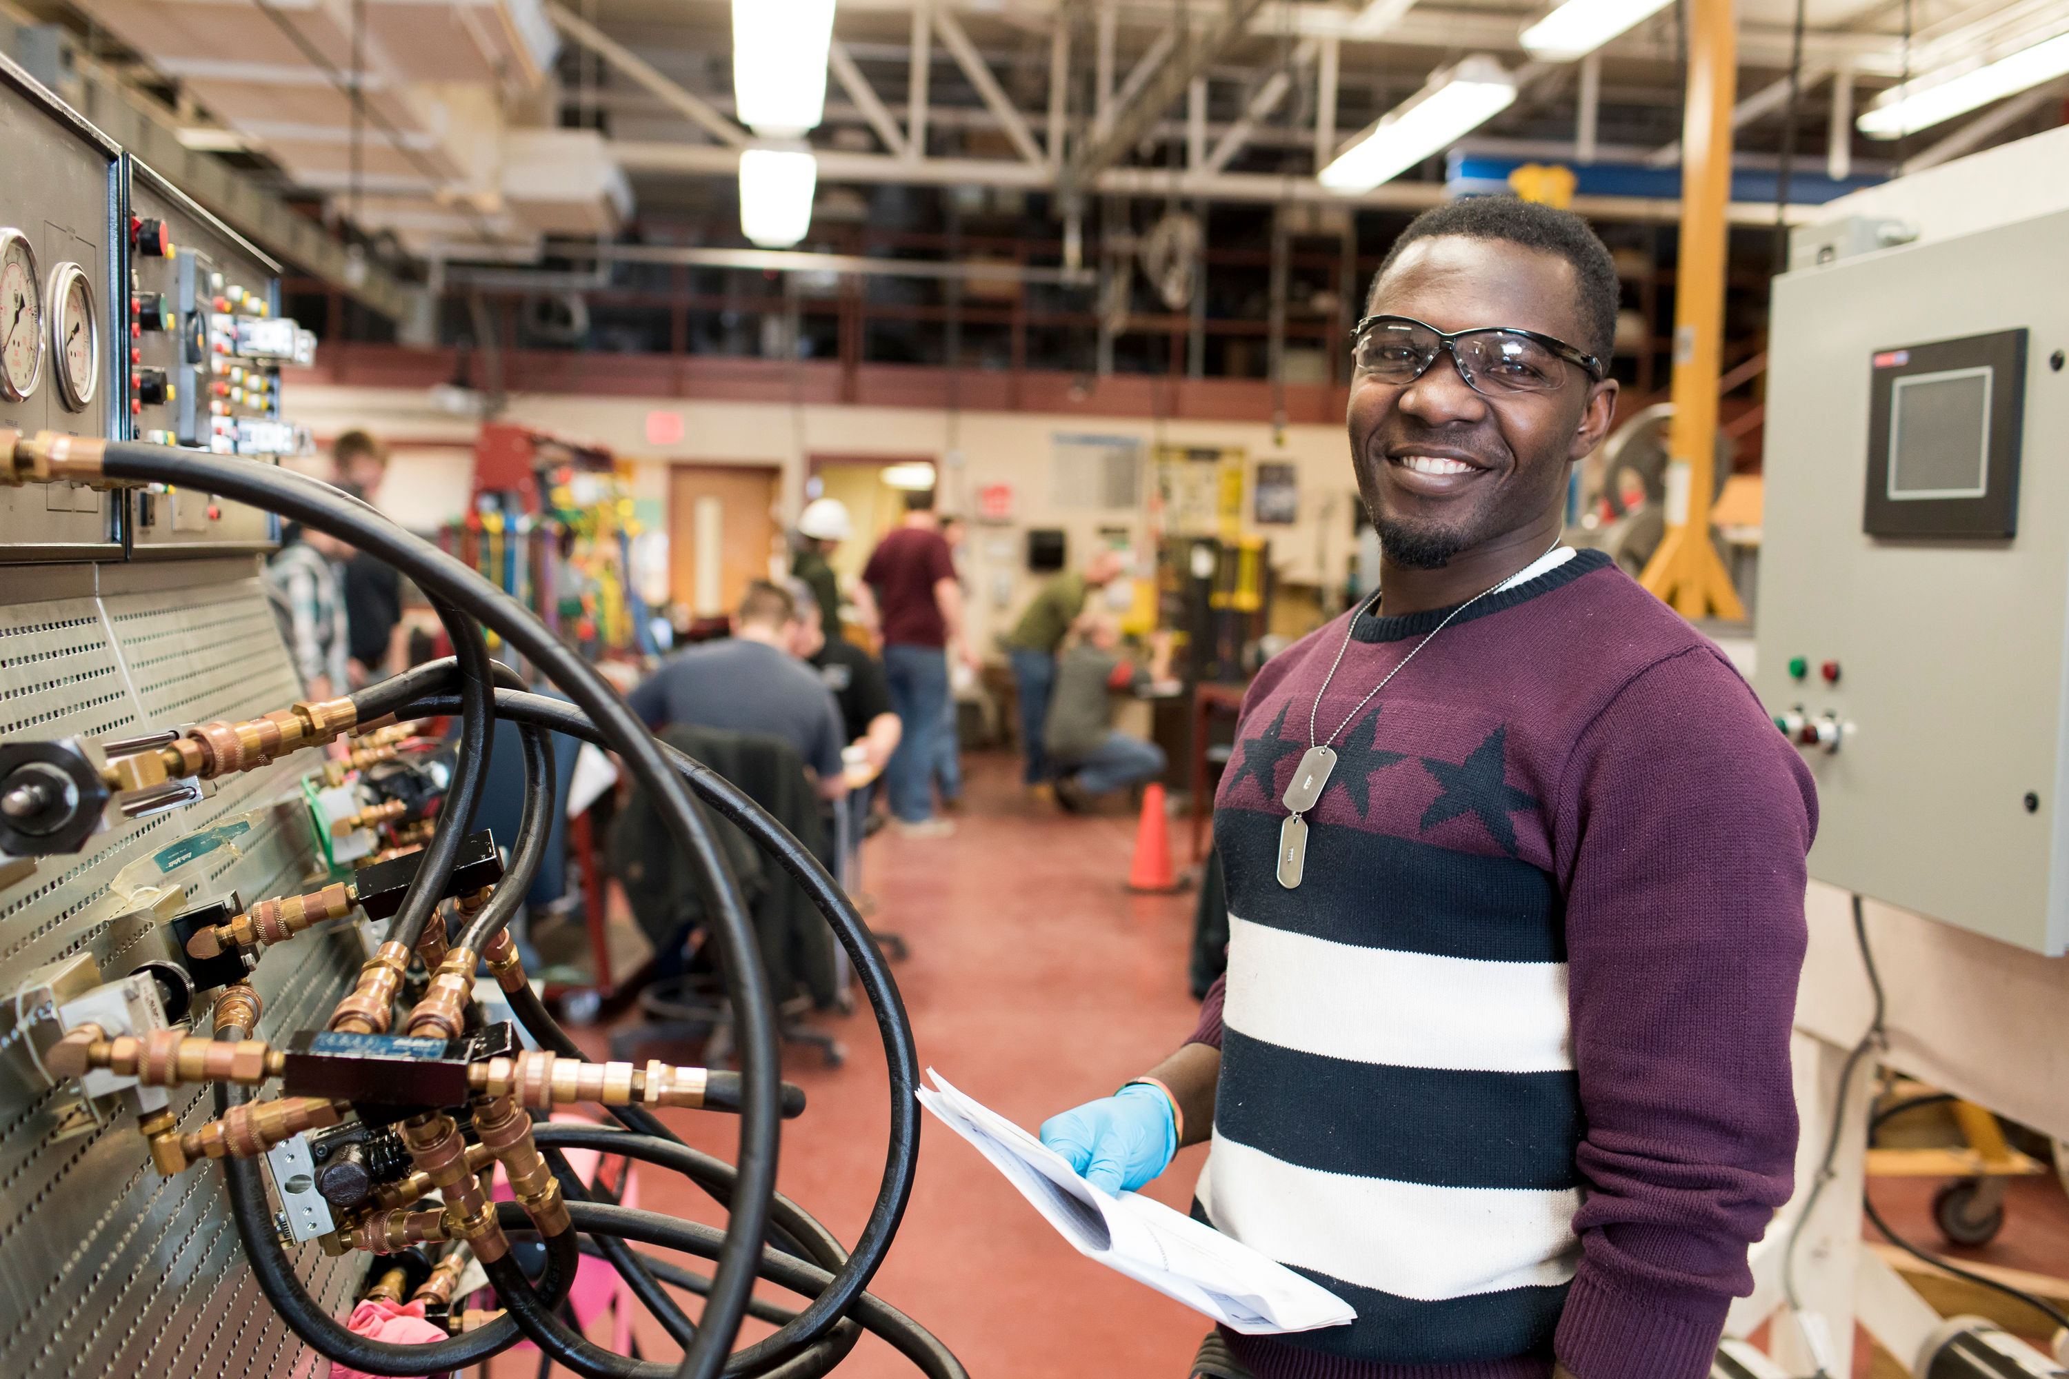
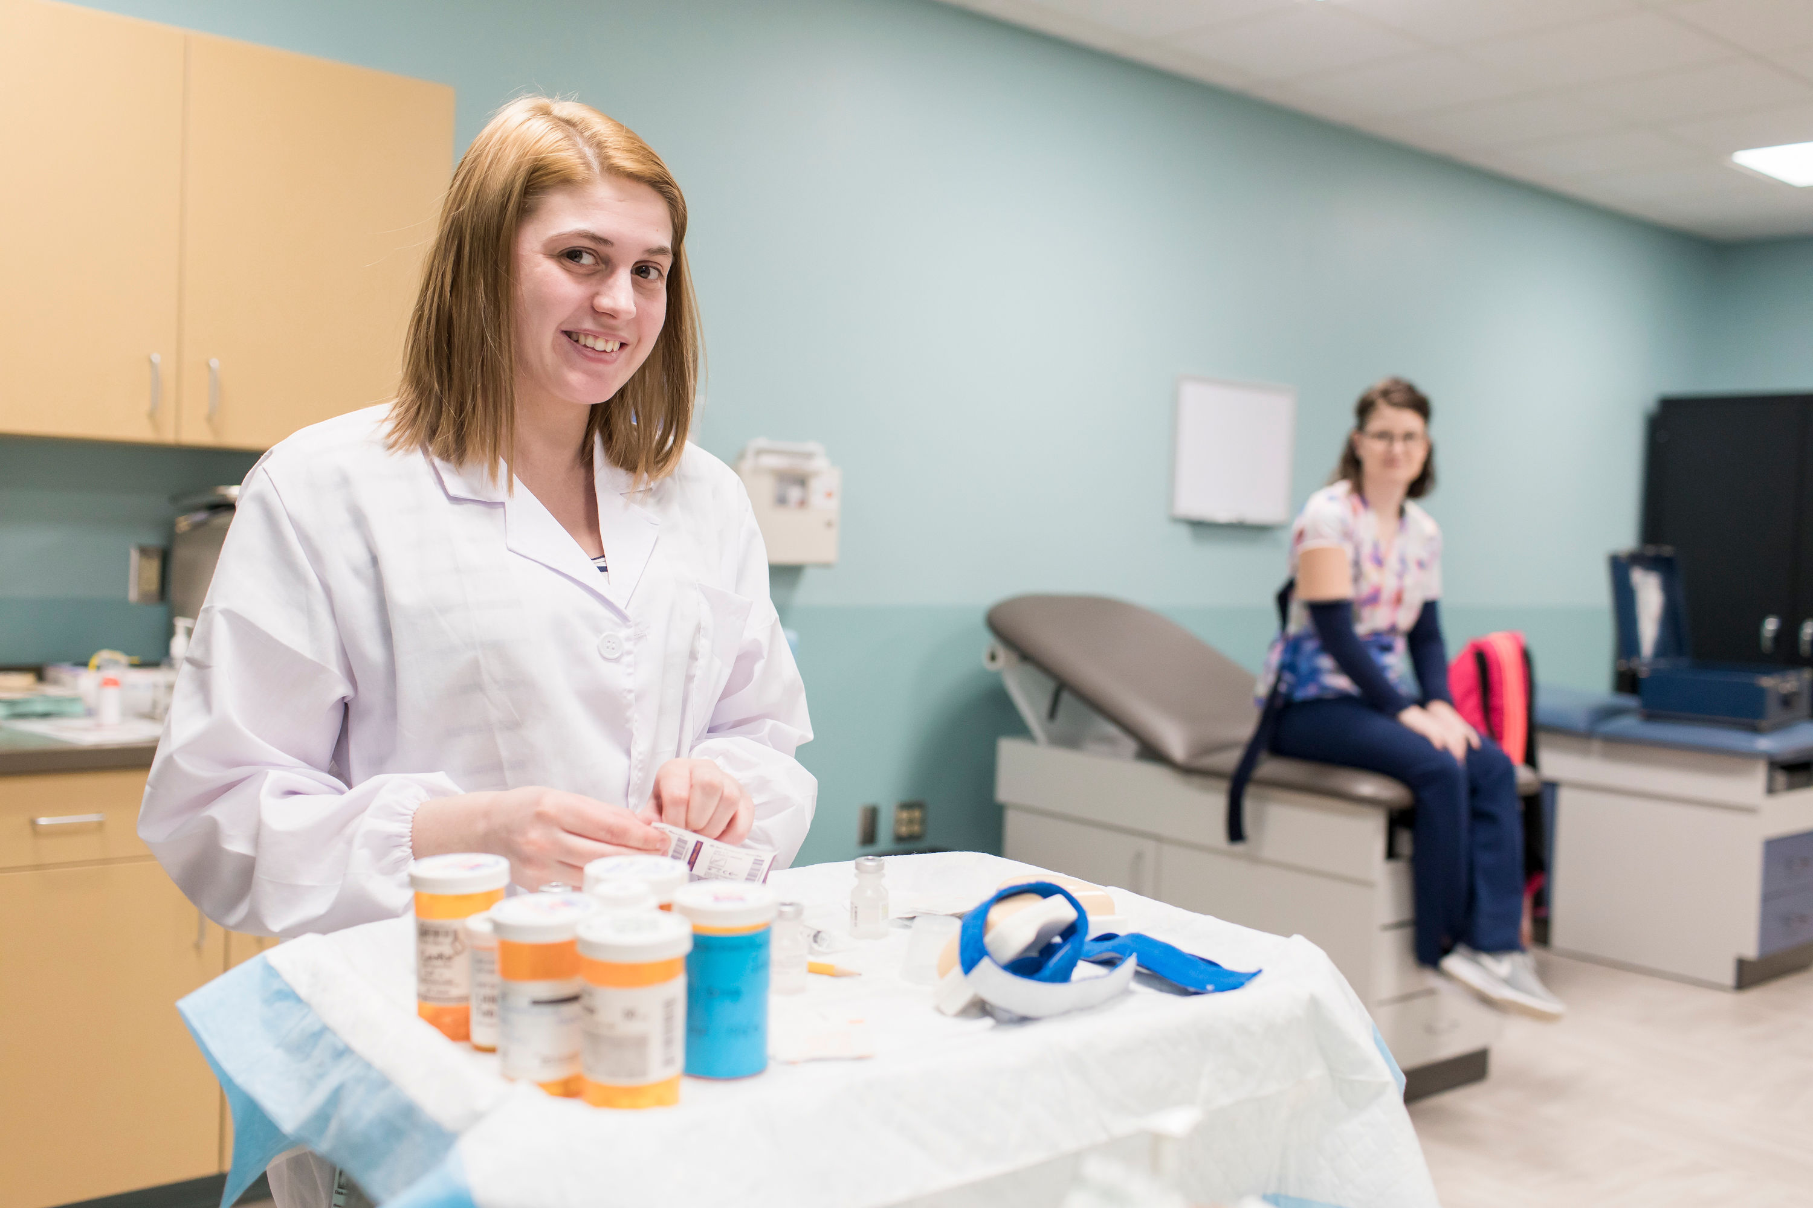
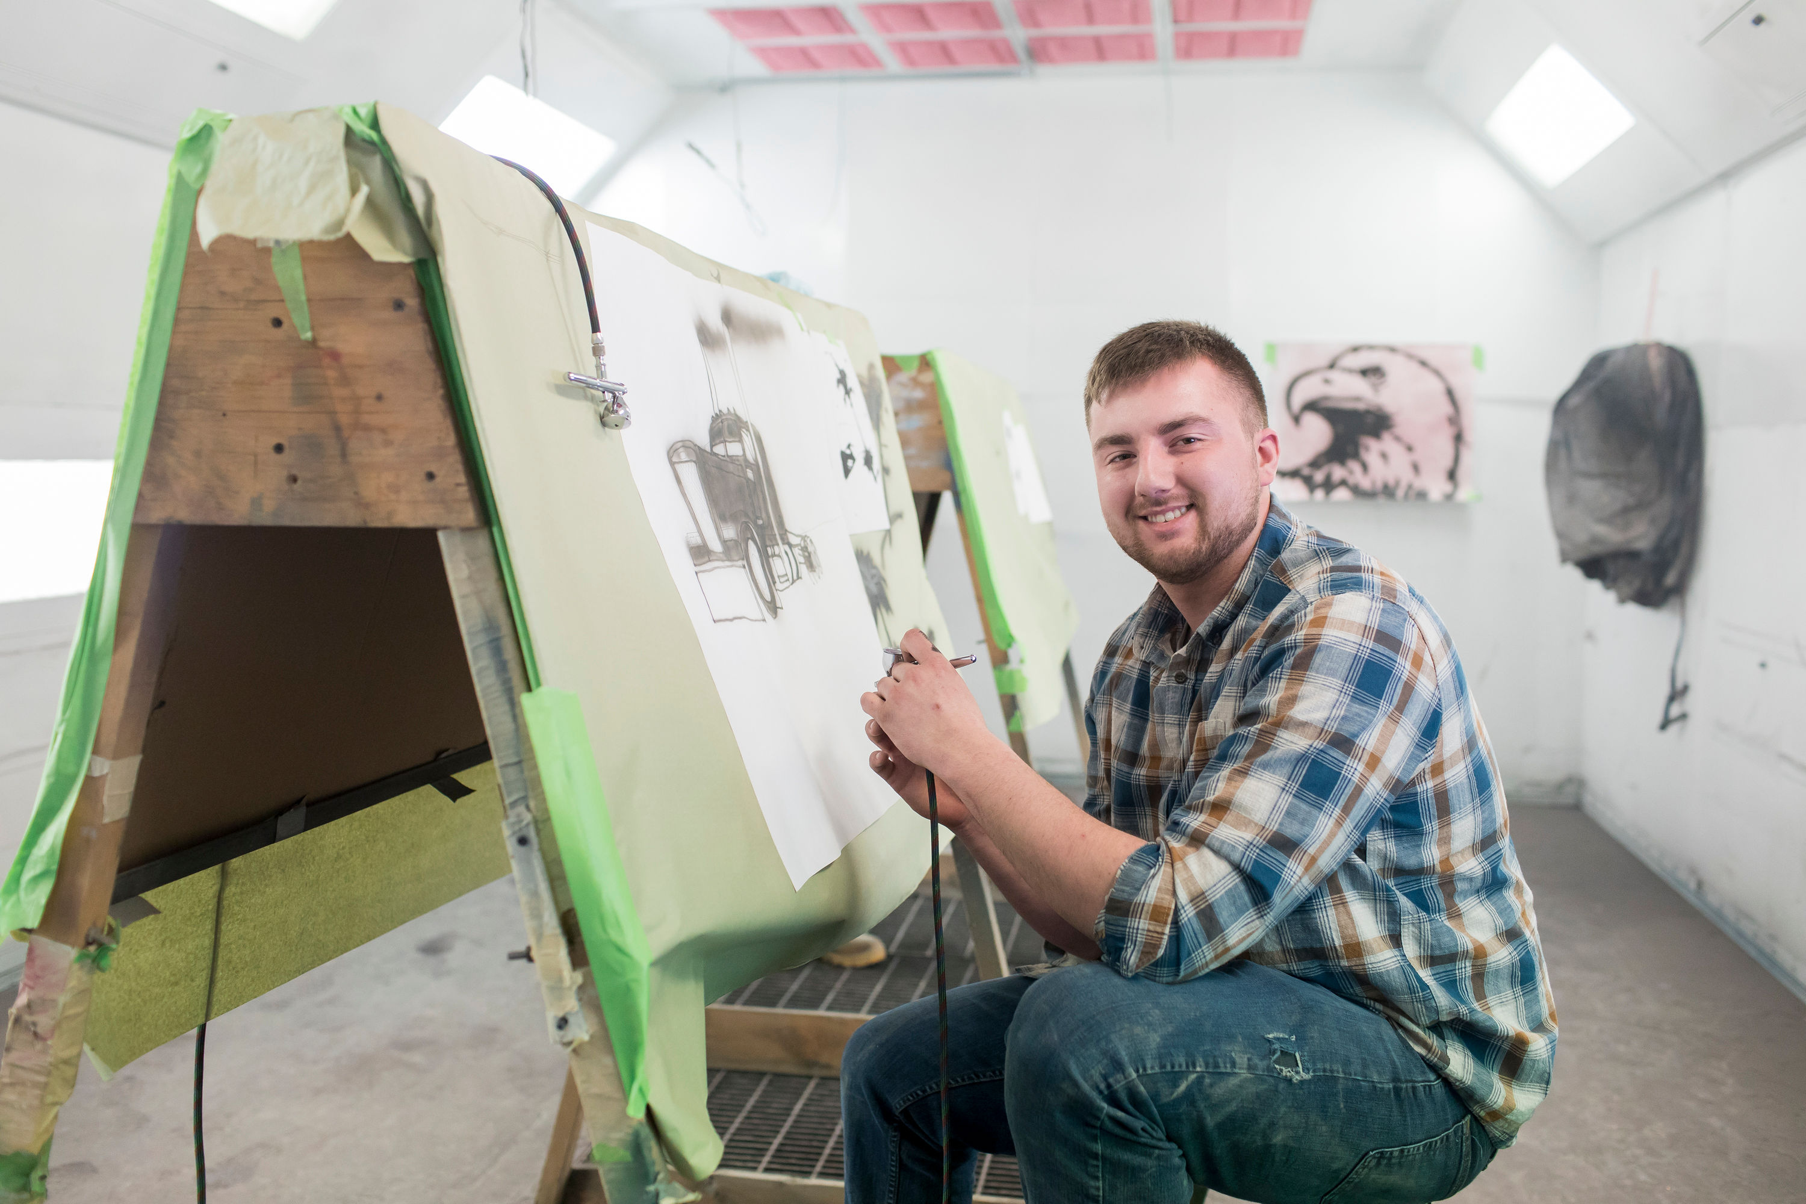
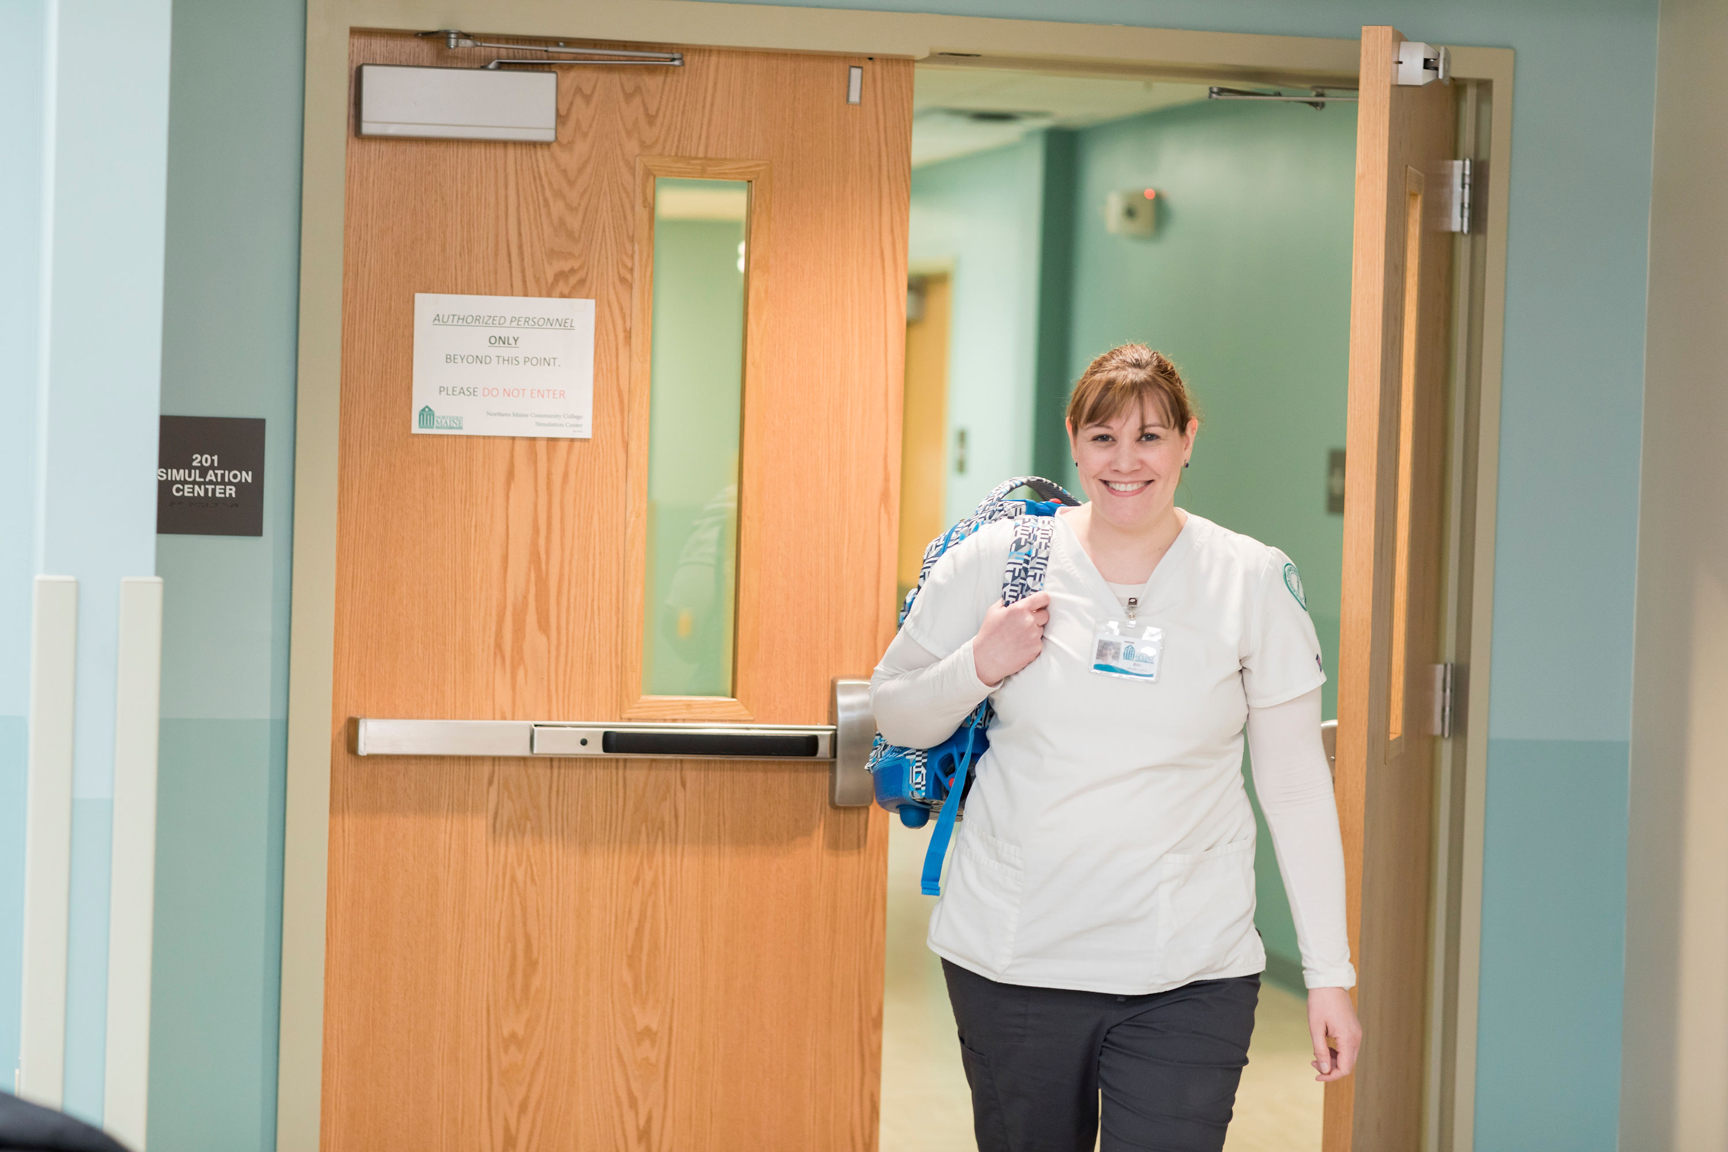
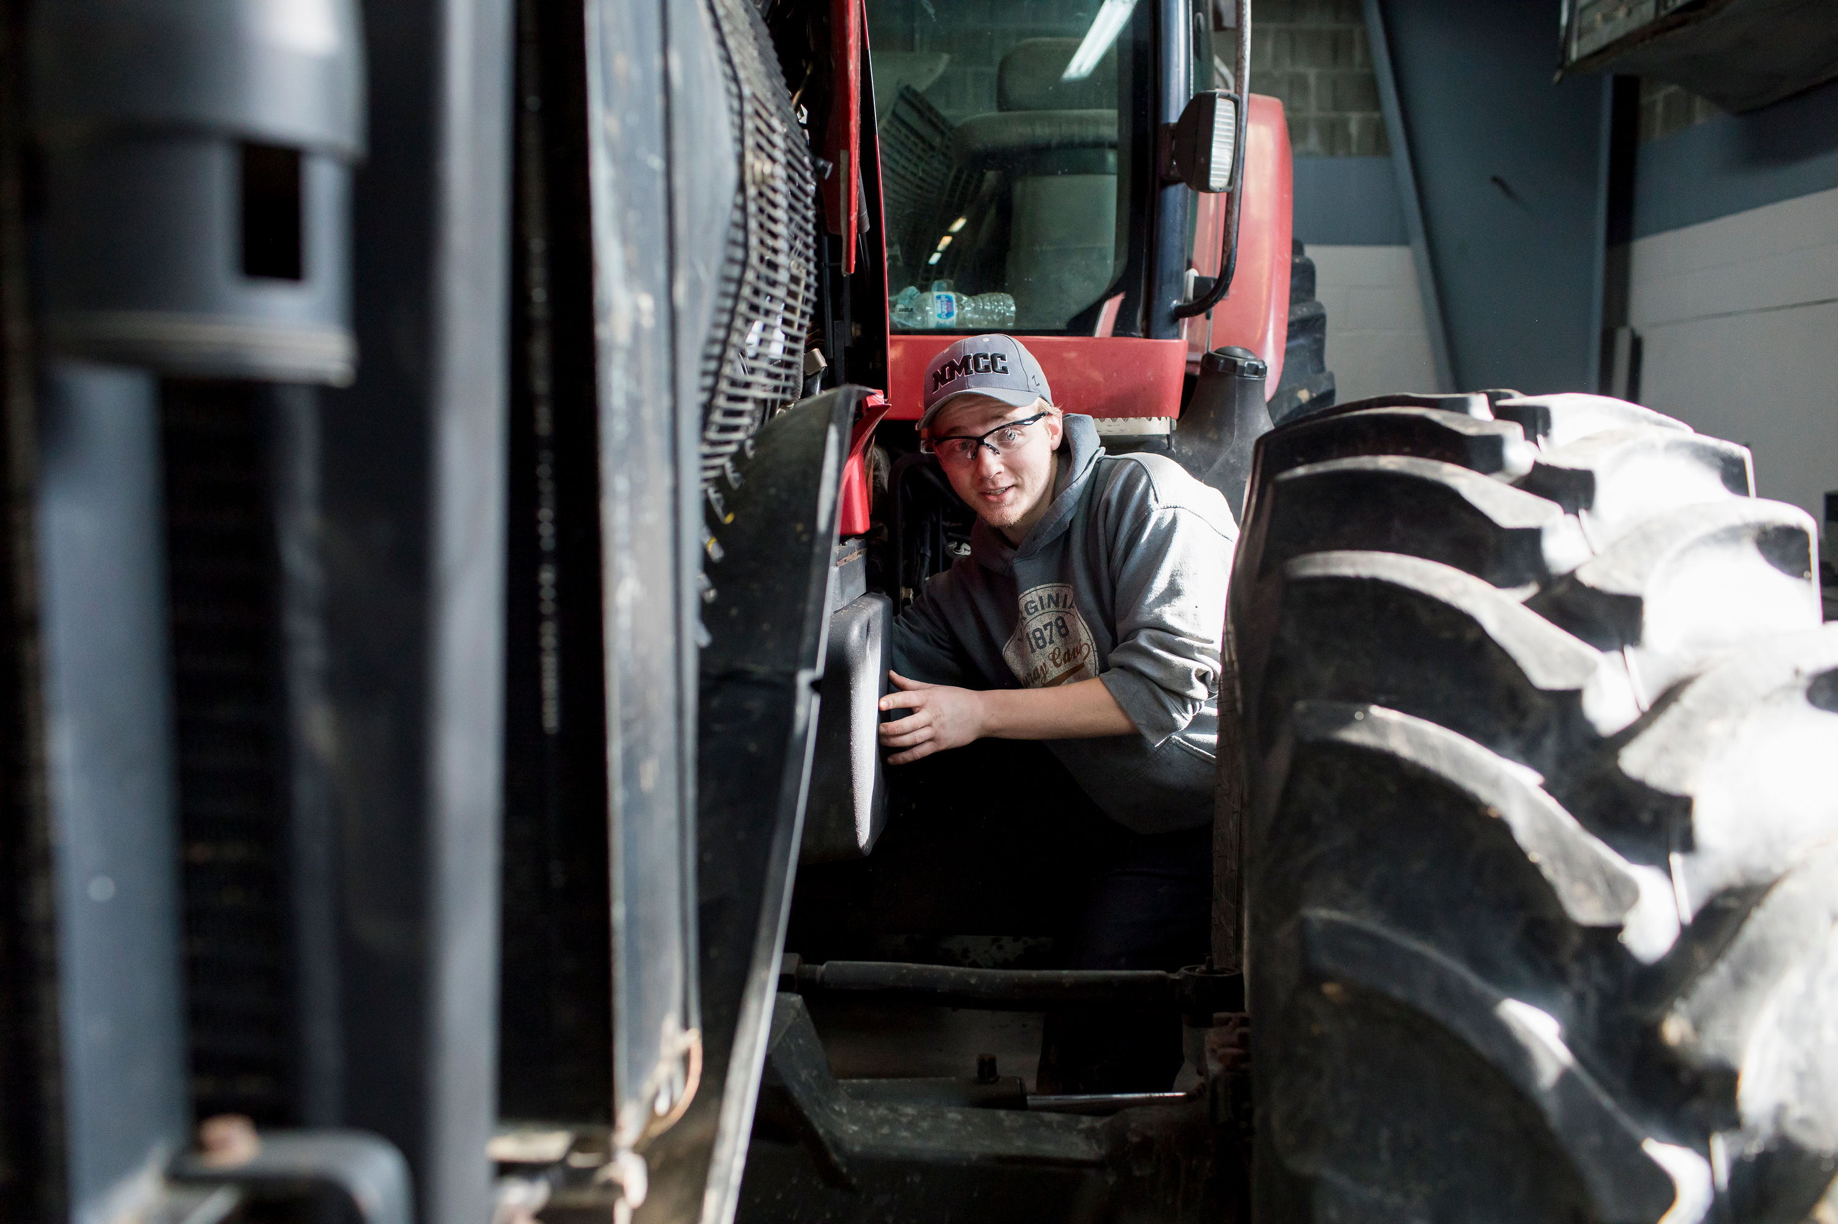
SUMMARY

